Slide 1
Community PROJECT
2023
VCE-VM - PDS UNIT 1-3 Term 3 - 4:

Slide 2
ACKNOWLEDGEMENT:
We proudly acknowledge the Traditional Owners,
Casey's Aboriginal communities and their rich culture and pay respect to their Elders, past, present and future.
We acknowledge Aboriginal people as Australia's First Peoples and as the Traditional Owners and Custodians of the land on which we live and work.

Slide 3
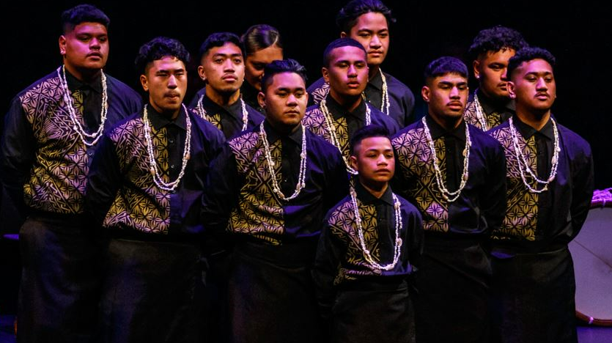
Unit 4 VCE-VM OVERVIEW (PDS)
Student to use project planning skills to implement a comprehensive plan to apply timely, affordable, and effective responses to a community issue.
Create a record of active implementation, participation, and execution of a planned project.

Slide 4
FINAL OUTCOMES FOR PDWRS:
UNIT 4: COMMUNITY PROJECT
AREA OF STUDY 1: Planning a community project
(PRE-PLAN 4C’s EVENT)
AREA OF STUDY 2: Implementing a community project
(Collation of evidence at the 4C’s EVENT)
AREA OF STUDY 3: Evaluating a community project
(Gathering of evidence and Final Oral Presentation)
Ideas for LITERACY
Prepare Eportfolio
Print relevant evidence only eg: certificates, CV, Resume
Edit to apply for a job that demonstrates WRS in 4C’s Community Services.

Slide 5
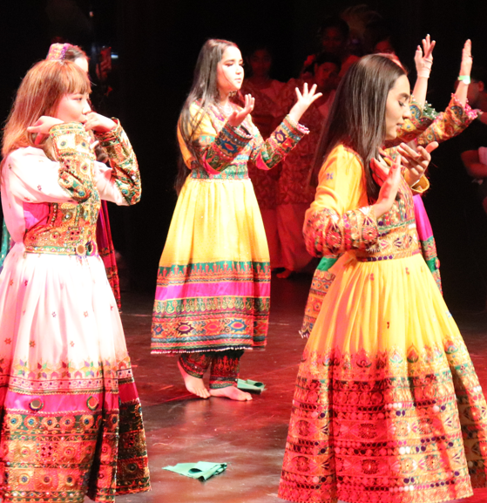
Outcome 2 continued…
WEEKLY: CREATE & COLLECT YOUR EVIDENCE:
ANNOTATED PHOTOGRAPHS: (PRE/DURING/POST)
(Students can attend practice to support our students during lunchtime, or groups of students working, evidence of tasks completed (snipping tool & annotate)
28th Augusts, 4th Sept 11th of Sept
PORTFOLIO & REFLECTIVE JOURNAL: Questions to complete as a group
EVIDENCE of participation in practical tasks Quality/Quantity/Presentation/Meeting roles, outcomes & reflections
VIDEO CLIPS – PRE/DURING THE EVENT/POST (Reflection)
Creating a record of survey results (POST- survey conducted on the day – what questions will you ask? How will it be delivered?)
A record of interviews with members of the community – live recordings
Build your PP Presentation as you go EVERY LESSON at least 2 slides are due at the end of the week that can contain reflections, creation of incomplete tasks, collaboration with peers, document feelings/frustrations emotions and document peer and teacher advice.
What have you learnt? Are there skills you need to learn/attain or understand to complete a task? Explain why you were not able to meet

Slide 6
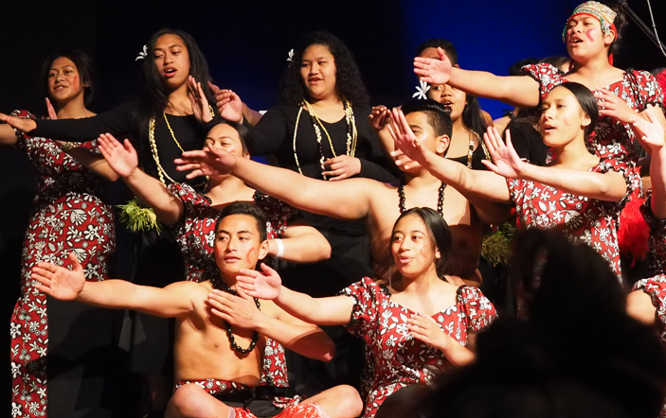
Outcome 3
Evaluate the effectiveness of the project planning and implementation, drawing together findings in a presentation to a relevant audience
EVIDENCE:
Annotated photographs
(On the day of the event)
FINALISE - A record of survey results (POST- survey conducted on the day)
FINALISE - A record of interviews with members of the community
FIinalise reflective journal of participation in practical tasks
(Portfolio)
A video – PRE/DURING THE EVENT/POST (Reflection)
PP Presentation – Delivery (see Outcome 2)

Slide 7
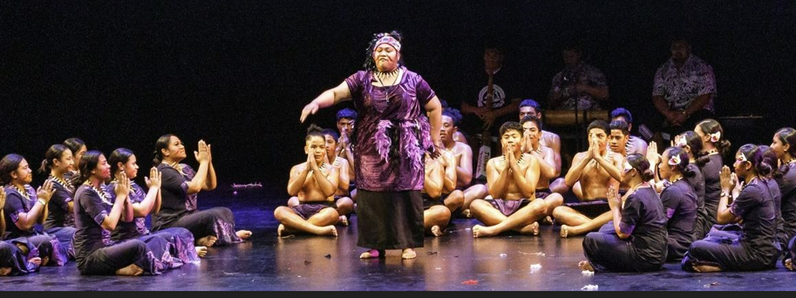
Outcome 3 continued…
ANNOTATED PHOTOGRAPHS:
Organisation journey from the beginning of the term to the
5th and/or 12th of Sept
A COMPLETED PORTFLIO OF ALL THE WEEKLY TASKS COMPLETED
Every week you would have completed a task associated with various tasks planning, WRS and visitation to Bunjil Place, creating posters, letters, etc…include those in your slides
VIDEO CLIPS – PRE/DURING THE EVENT/POST (Reflection) social cohesion?
A record of interviews with members of the community – live recordings
Creating a record of survey results POST- survey conducted on the day – what were the questions asked? And how was it delivered?
AN OVERALL REFLECTION PRE/DURING/POST
FINAL Delivery of PRESENTATION
You will share your PP journey to an audience.

Slide 8
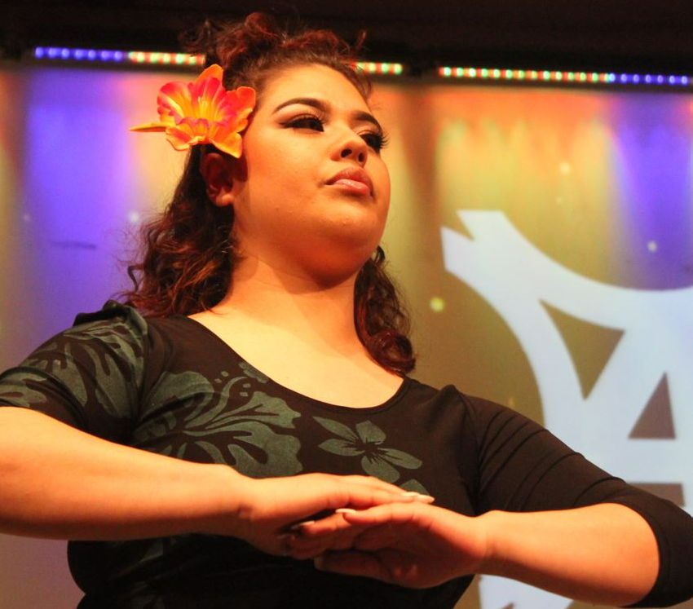
Outcome 3
Evaluate the effectiveness of the project planning and implementation, drawing together findings in a presentation to a relevant audience.
FINAL DELIVERY
(8-10 min presentation)
Your FINAL PP
must include the following:

Slide 9
ORGANISING SCHOOLS
PERFORMERS
ORGANISERS VCE-VM students
Night 1 - LYNDHURST SC
Night 2 - CRANBOURNE EAST SC
Night 3 – LYNDHURST SC/
CRANBOURNE EAST SC
ART SHOW – GLENEAGLES SC

Slide 10
LEADERS Work Placement
Lyndhurst SC & Cranbourne East SC PDWRS
Year 11/12 4C’s Leaders to develop a Community partnership to organize and run 4C’s in 2023

Slide 11
OVERVIEW: Who are the 4C’s Stakeholders?

Slide 12
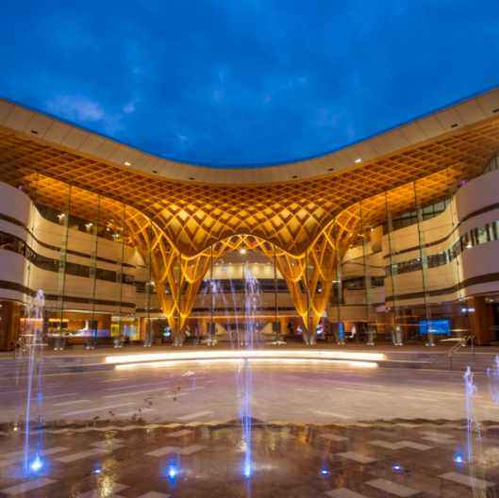
OVERVIEW: WHAT ARE
STAKEHOLDERS?
Stakeholders are those
with an interest in your project's outcome
and are typically
Members of a project team
Project managers
Executives
Project sponsors
Customers and participants of the program

Slide 14
4C’s STAKEHOLDERS
BUNJIL PLACE (City of Casey)
ERDI FOUNDATION (Sponsor)
LE MANA (CMY Centre for Multicultural Youth)
VICTORIAN POLICE (Multicultural Casey/Dandenong)
GRACE CONNECTIONS Community/Charity work
MUSEUM/STATE LIBRARY Jade Hadfield- Curator from Melbourne Museum to Bunjil Place.

Slide 15
4C’s STAKEHOLDERS
BUNJIL PLACE (City of Casey)
ERDI FOUNDATION (Sponsor)
LE MANA (CMY Centre for Multicultural Youth)
VICTORIAN POLICE (Multicultural Casey/Dandenong)
GRACE CONNECTIONS Community/Charity work
MUSEUM/STATE LIBRARY Jade Hadfield- Curator from Melbourne Museum to Bunjil Place.

Slide 16
You will be required to complete a detailed Q&A on each of our Community Connections-Stakeholders
BUNJIL PLACE (City of Casey)
LE MANA (CMY Centre for Multicultural Youth)
VICTORIAN POLICE (Multicultural)
GRACE MINISTRIES (Retired PI dads/Dad &
Grandpas-Security support)
ADRA – Community Services

Slide 17
4C’s Student Leadership roles
available in 2023
There will be 4C’s STUDENT LEADERSHIP positions available during work placement days (Weds/Fri) with Ms. Laitini Matautia-Ulugia, Director and Founder of 4C’s in 2024
Meet the current Student Leaders organising 4C’s in 2023

Slide 18
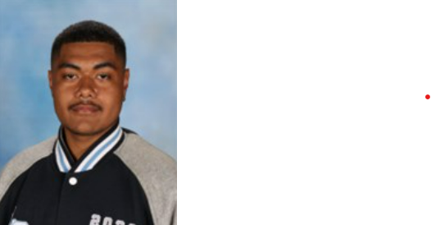
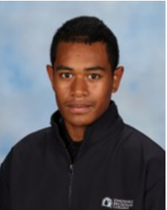
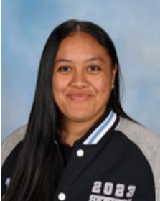
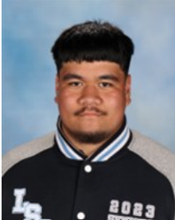
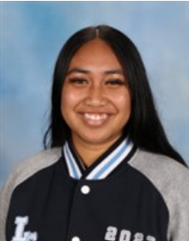
.
LSC 4C’s LEADERS/Work Placement 2023
Kelevi
KALISOQO
Year 12
Sonia
TETU
Year 12
Jordan
MOIMOI
Year 12
Elizia
SAU
Year 12
Seyn
Betham
Year 12

Slide 19
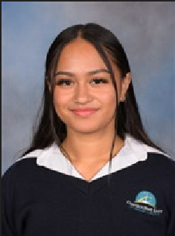
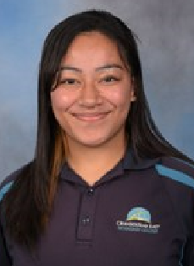
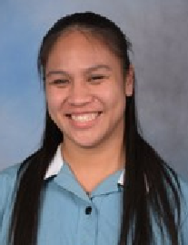
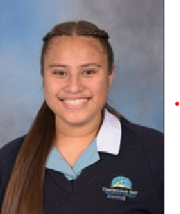
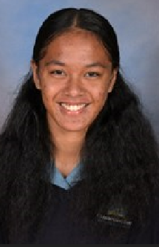
.
CESC 4C’s LEADERS/Work Placement 2023
Kitiana
KATOPAU
Year 11
Sailalele
FINAU
Year 12
Stephanie
POSINI
Year 12
Annaleigh
POLUTEA
Year 12
Se’epa
VINEULA
Year 12

Slide 20
“Cultivating creative cultures with communities “ through INCLUSION, INTEGRITY & RESPECT
Ms. Laitini Matautia-Ulugia - Director & Founder of 4C’s

