Slide 1
WHAT DO YOU KNOW ABOUT THE 4C’S PROGRAM? What does the 4C’s stand for? PROMOTIONAL VIDEO https://vimeo.com/752773525/c2011d82a2

Slide 2
“Cultivating creative cultures with communities “ through INCLUSION, INTEGRITY & RESPECT
Ms. Laitini Matautia-Ulugia - Director & Founder of 4C’s

Slide 3
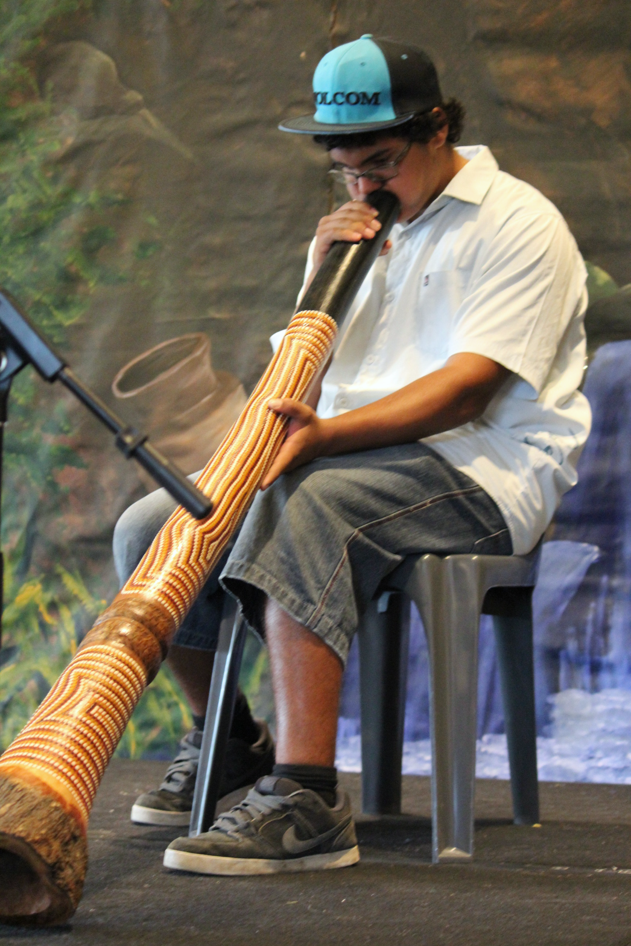
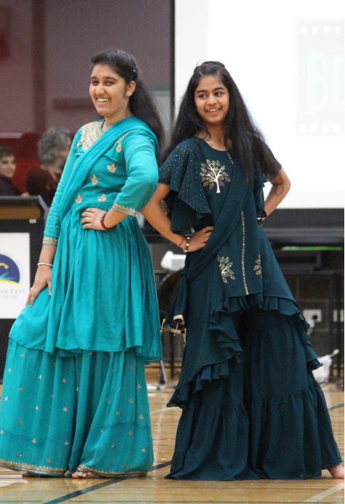
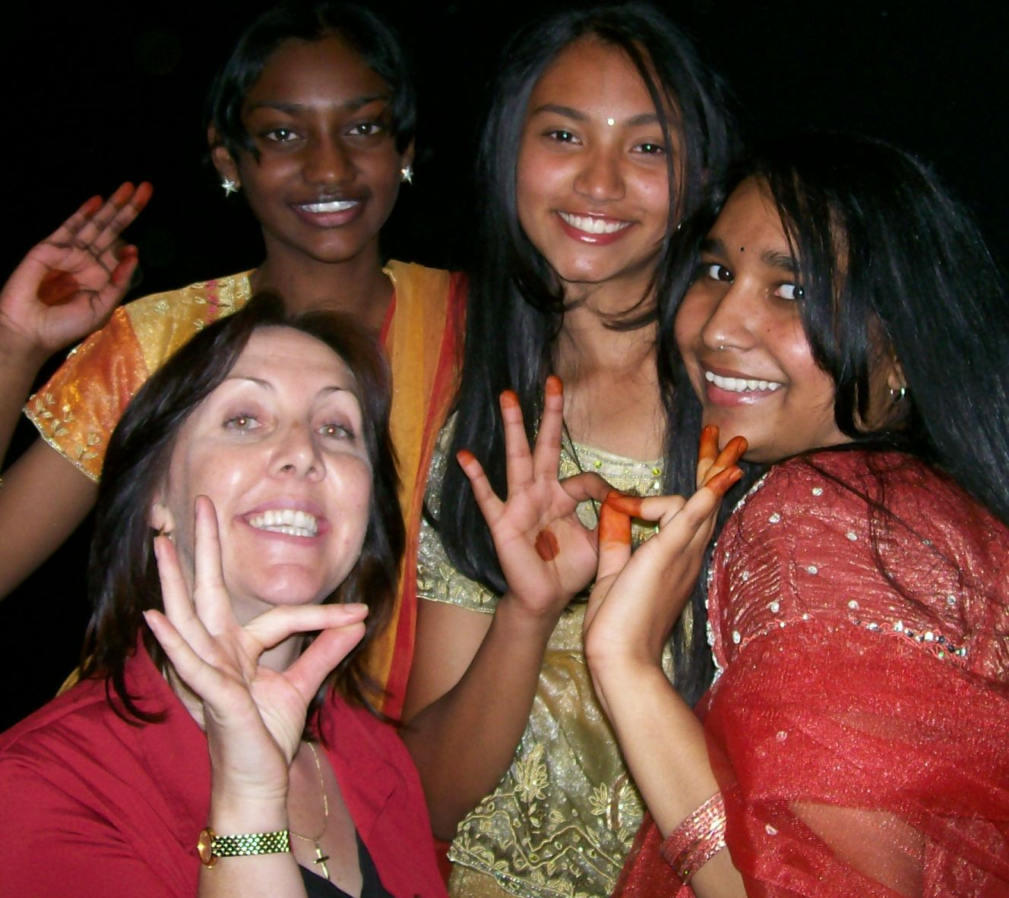
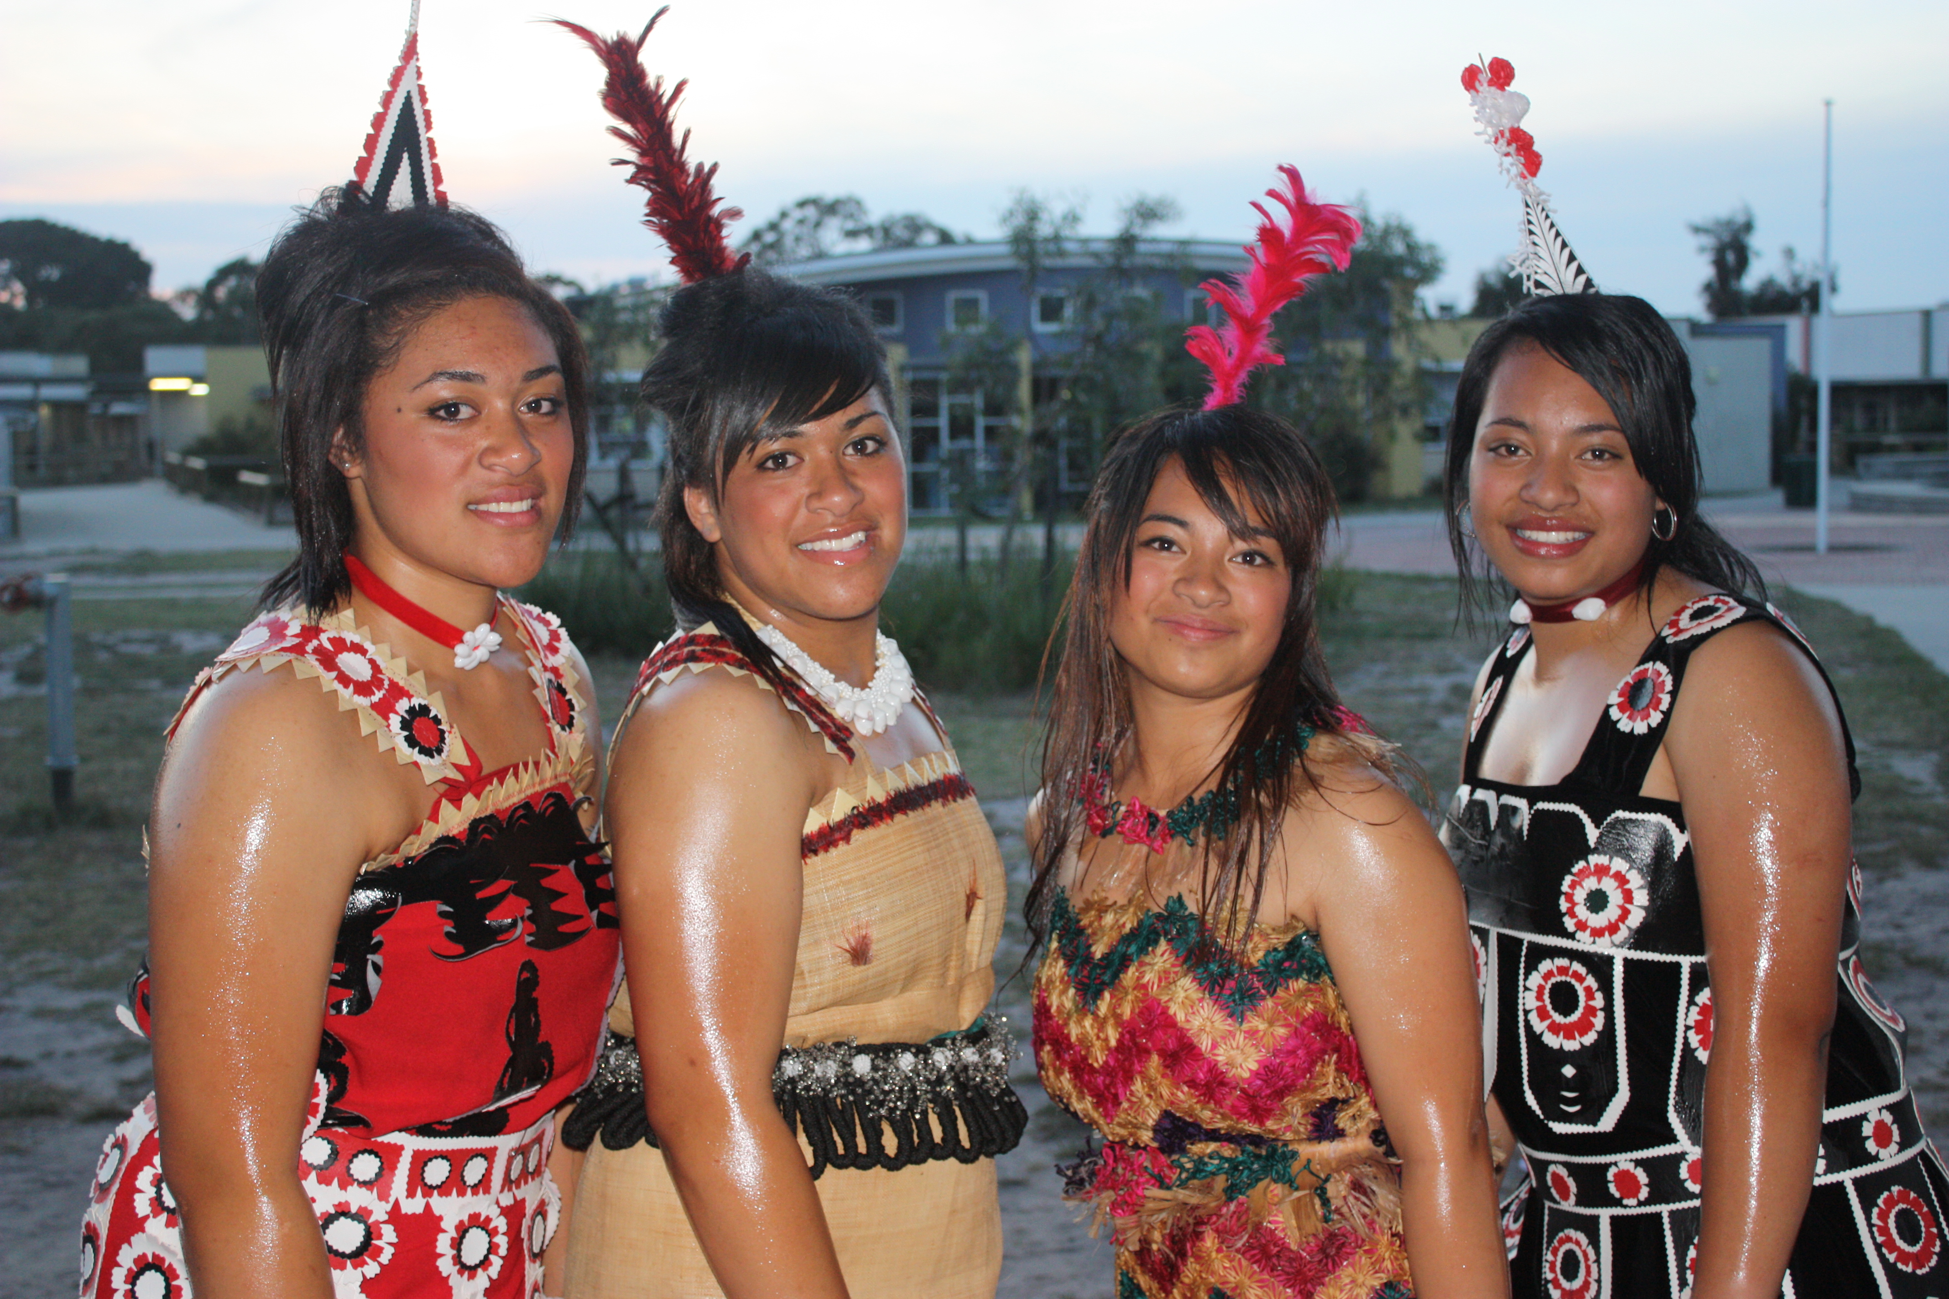
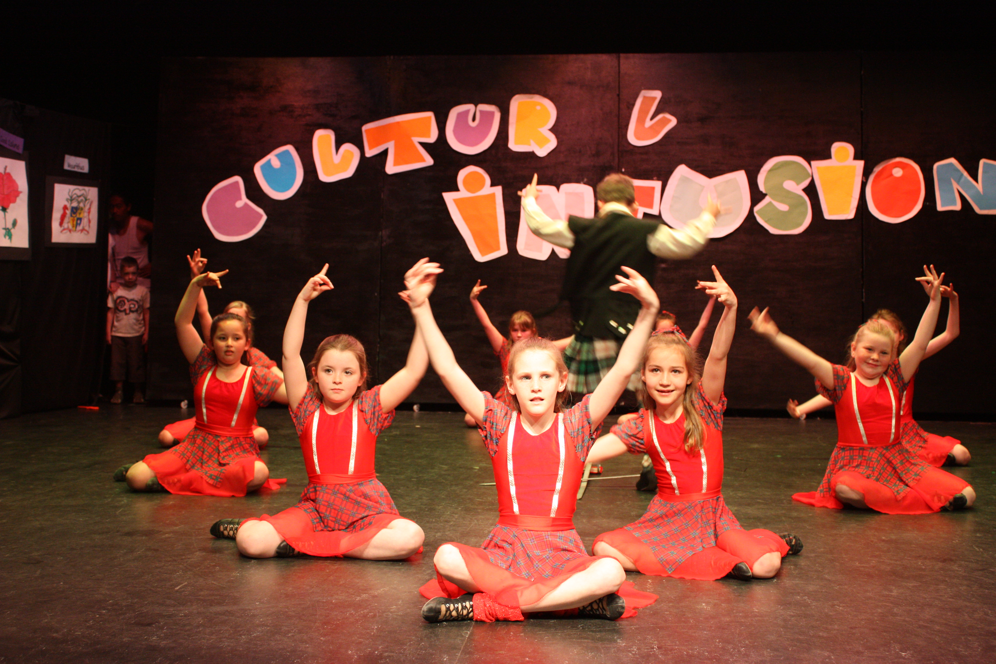
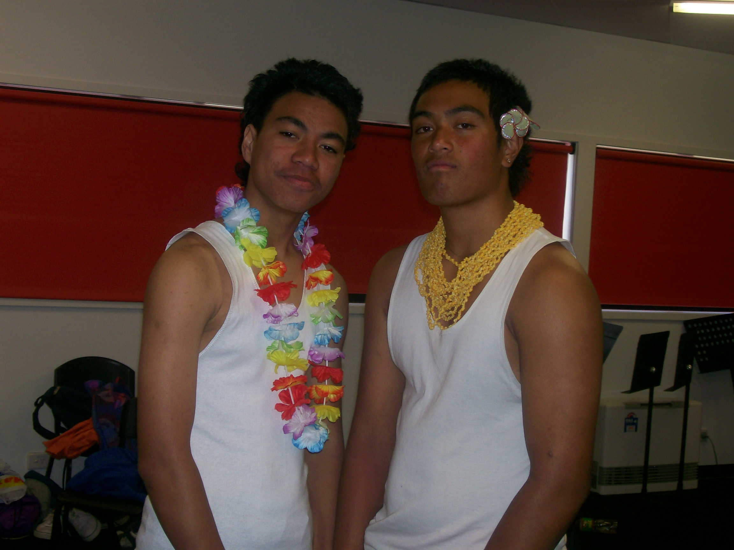
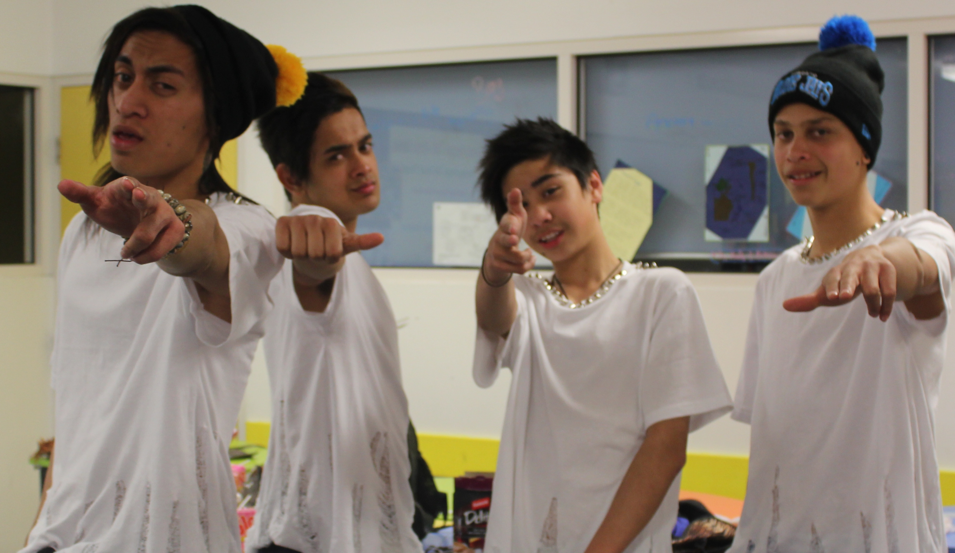
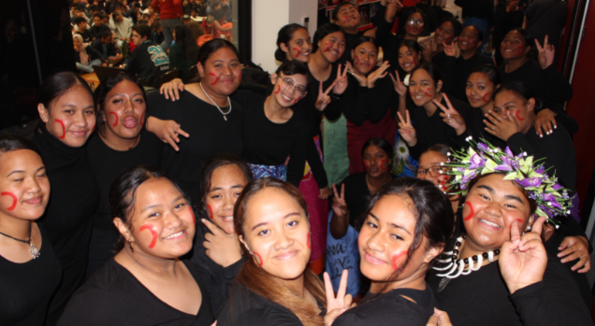
2007 the conception of 4C’s
2007 – 2008 Anti-social behaviour
Students – disengaged from school and their peers.
Their solution:
Music and Dancing.

Slide 4
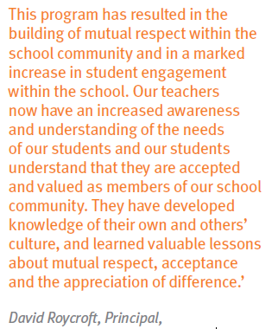
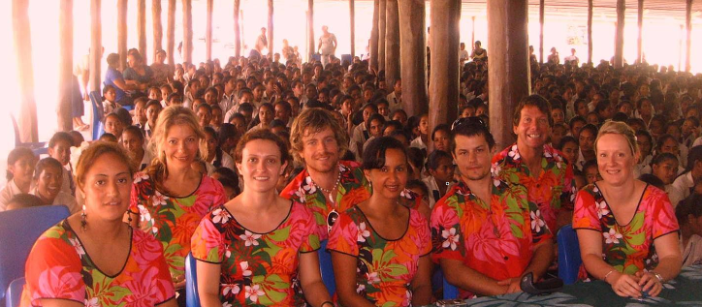
2007 - 2008 4C’s
Inspired Teaching PD in Samoa with our school psychologist
Collected school resources and PD for the remaining staff.
Pen Pals – CDSC students were provided with letters from Samoa
Interpreter for families at school
We began working in class on
projects like cultural inclusion.
- We entered competitions and won.

Slide 5
AWARDS & ACHIEVEMENTS 2006 Won ‘Teacher Award’ Cultural Diversity – Parliament House (information viewed at 2008 Middle Years students won the Cultural Diversity awards – Parliament House 2009 Middle Years students won the Cultural Diversity Awards – Parliament House 2011 Carrum Downs Secondary teacher received the ‘Victorian Multicultural Awards for Excellence’ (from Governor’s house and presented by the Education Minister) 2013 Individual student award linked to the 4C’s 2014 VCAL Teacher Achievement Award 2015 VCAL Frankston/Mornington Peninsula ‘Best Practice Award’ (VCAL Year 11 – 12) 2018 Keynote speaker for VALA Celebrating Diversity – 4C’s 2019 Bunjil Place partnership established with 4C’s and Communities
AWARDS & ACCOMPLISHMENTS

Slide 6
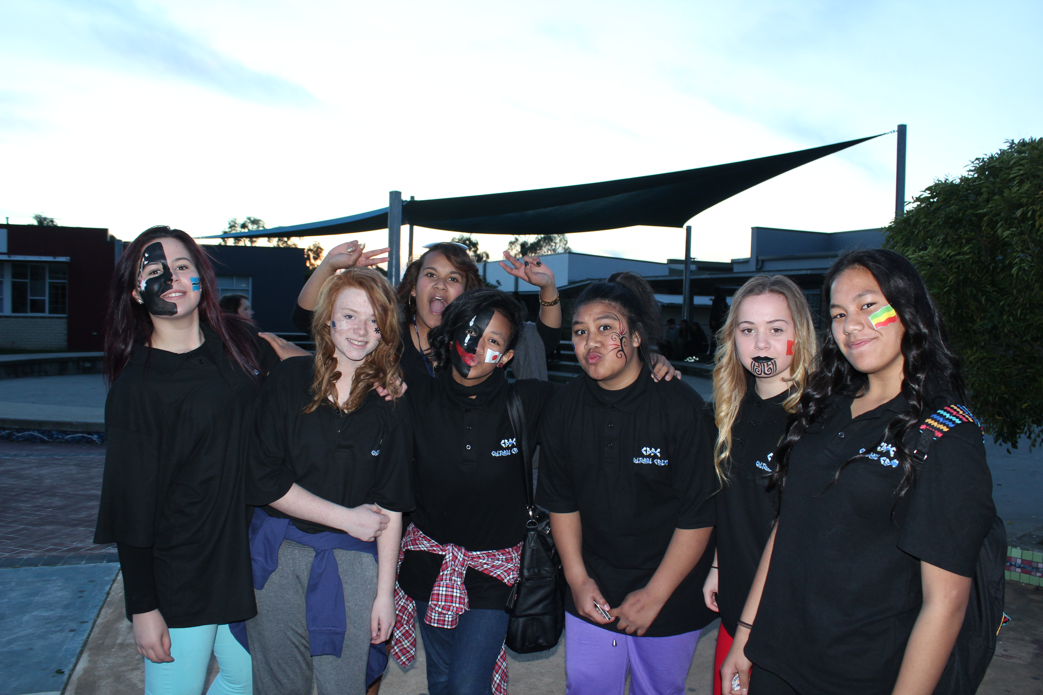
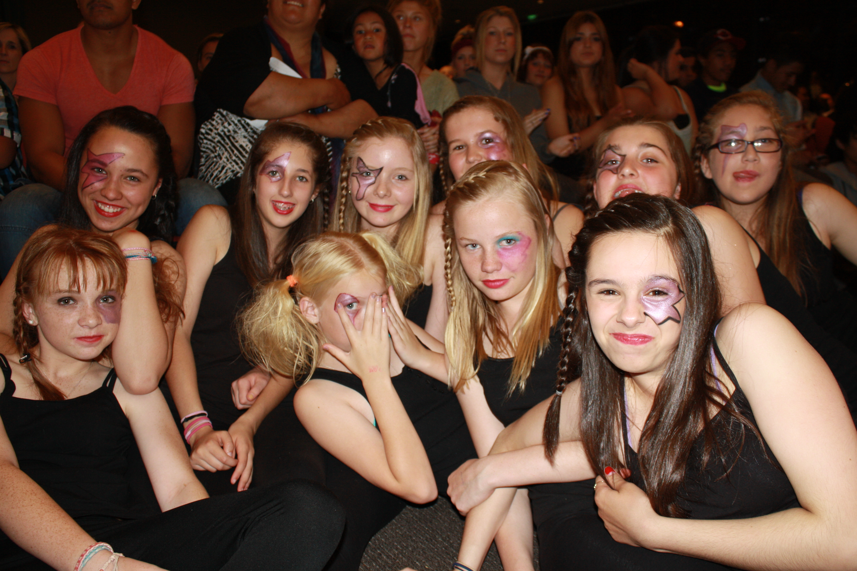
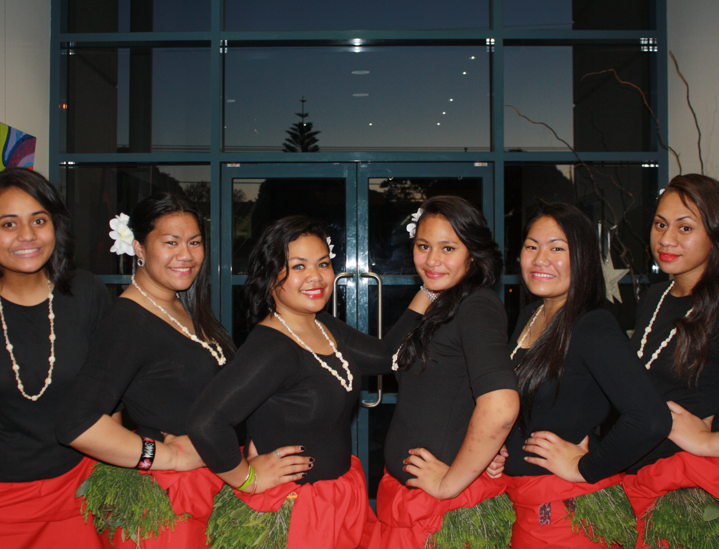
Was a VCAL PROGRAM built by students linking them to outcomes NOW it is being linked to VCE-VM PDS
Our initial GOAL was to address racist issues and behaviour in our schoolyard to:
Changing cultural stigma in our schools and communities
- to improve school engagement & Wellbeing
- to increase school pride
to celebrate the inclusivity of Multi-cultural, dances, religions &
creative artists.
- to increase community partnerships by organising a common interest for young people to celebrate and showcase their culture.
- Strengthen family, school, and community bonds.

Slide 7
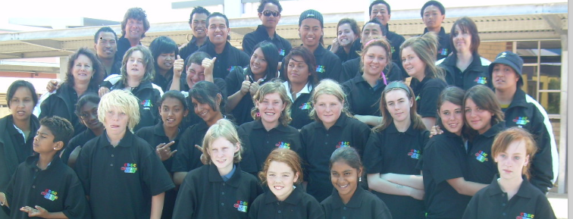
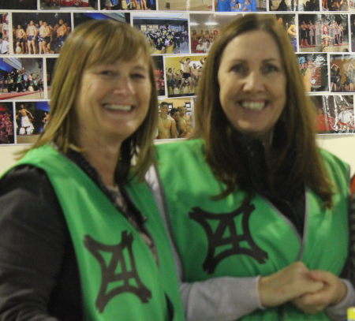
STUDENT VOICE/AGENCY
Students began to negotiate their roles. They wanted to choose activities that could be used to tick off their outcomes.
I was fortunate enough to be in a school that was able to support students with negotiated curriculum.
A lot of what the students wanted to do met VCAL outcomes, so 4C’s became a program that was targeted to all students.
4C’s is now in its 17th year (2023) and is being organised by Year 11/12 students. This project meets all PDWRS, LITERACY & NUMERACY OUTCOMES. However, CESC is only going to focus on the PDWRS unit.

Slide 8
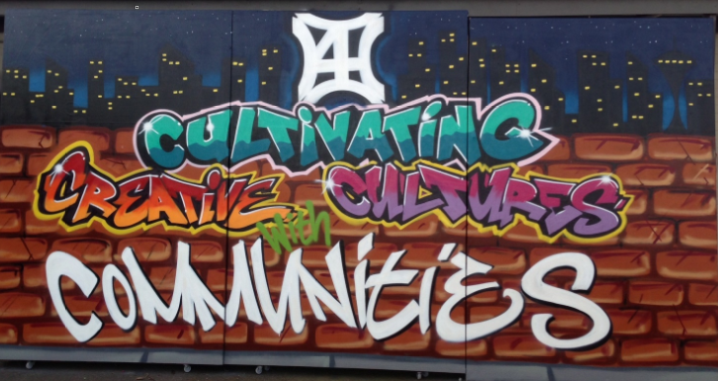
4C’s - Curriculum Literacy & numeracy PDS/WRS Advertising
Community sponsorship
Use of various electronic programs eg: Photoshop,
Community engagement
Visual Arts – painting backdrops
Professionalism/meeting deadlines
Feedback
Budgeting
Action Plan
Planning and Organisation
Copyright laws

Slide 9
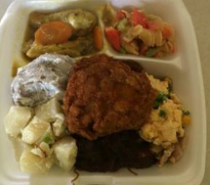
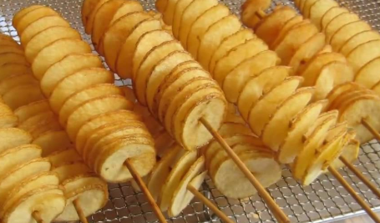
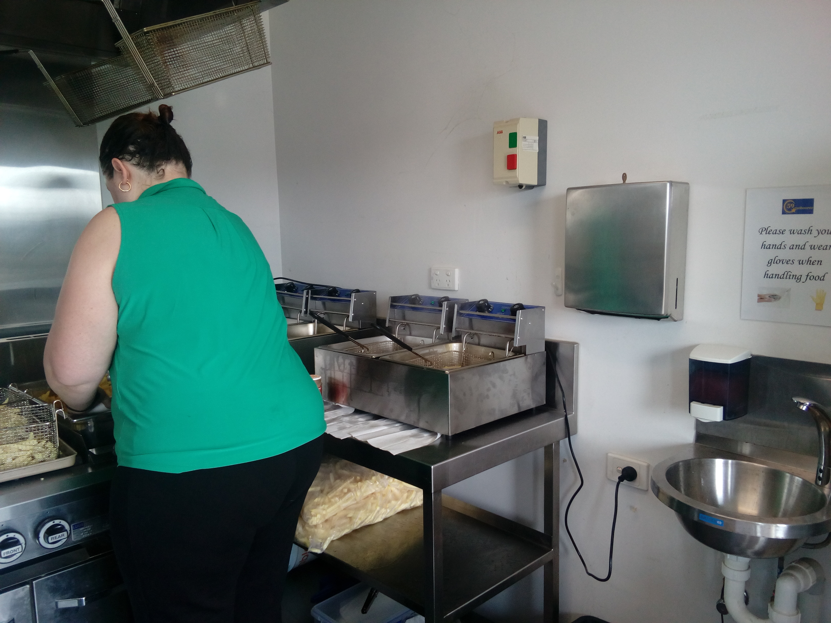
4C’s Curriculum Literacy & numeracy WRS/PDS FUNDRAISING
Oral skills – confidence in speaking and negotiating prices.
Food Handling Certificate
OHS rules
Community support to purchase food
Advertising leading up to the event
Budgeting
Action Plan - goals
Planning and organisation – prior and post the event
Inclusivity
Problem solving

Slide 10
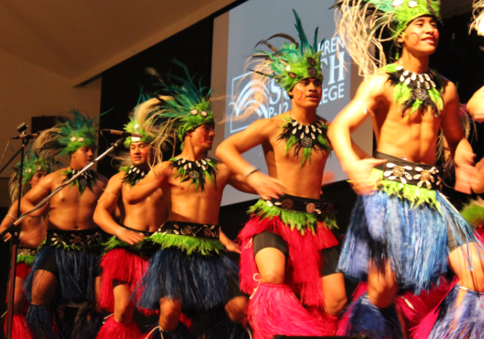
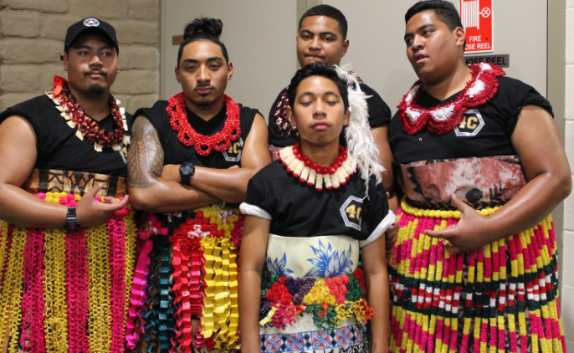
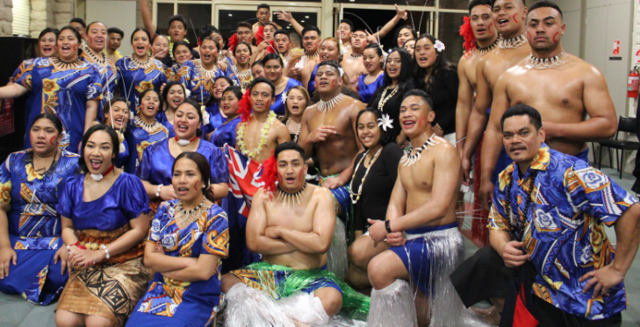
4C’s Curriculum Literacy & numeracy WRS/PDS CULTURAL FASHION & DESIGN
Cultural Dress – Choice of cultural design
Budgeting
Community support
Sustainable materials
Uniform
Cost effective for a large group
Negotiating cultural differences

Slide 11
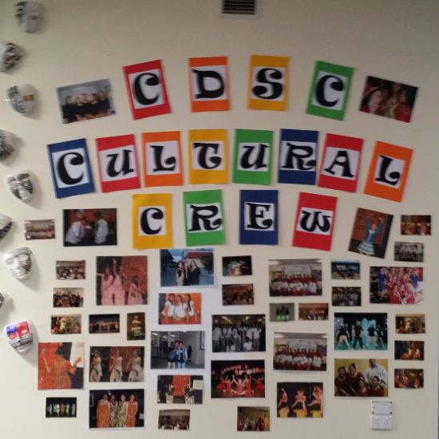
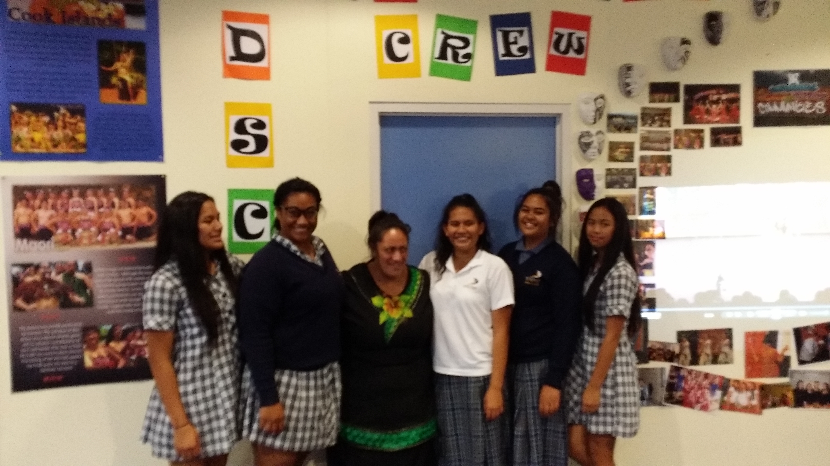
Curriculum Literacy & numeracy WRS/PDS SCHOOL OPEN NIGHTS
School Pride
Connectedness to Community
Oral presentation
Teamwork
Knowledge of Culture
Understanding connections to the wider Community
Creativity
Accessing Resources
Student potential/possibilities

Slide 12
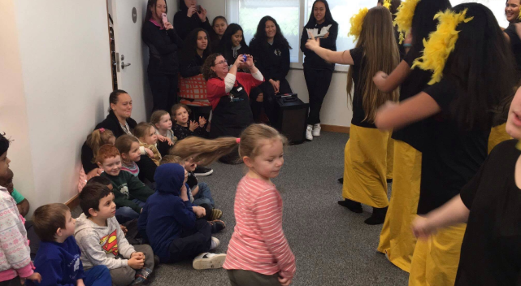
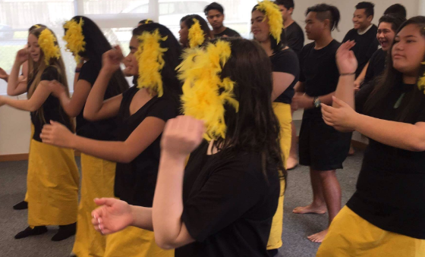
4C’s Curriculum Literacy & numeracy WRS/PDS COMMUNITY ENGAGEMENT PRIMARY SCHOOLS & RETIREMENT HOMES
School Pride
Connectedness to Community
Sharing cultural dance/knowledge
Teamwork
Popular culture – ‘Moana’
Understanding connections to the wider Community
Agility, fitness and perseverance
Accessing Resources
Student Leadership skills

Slide 13
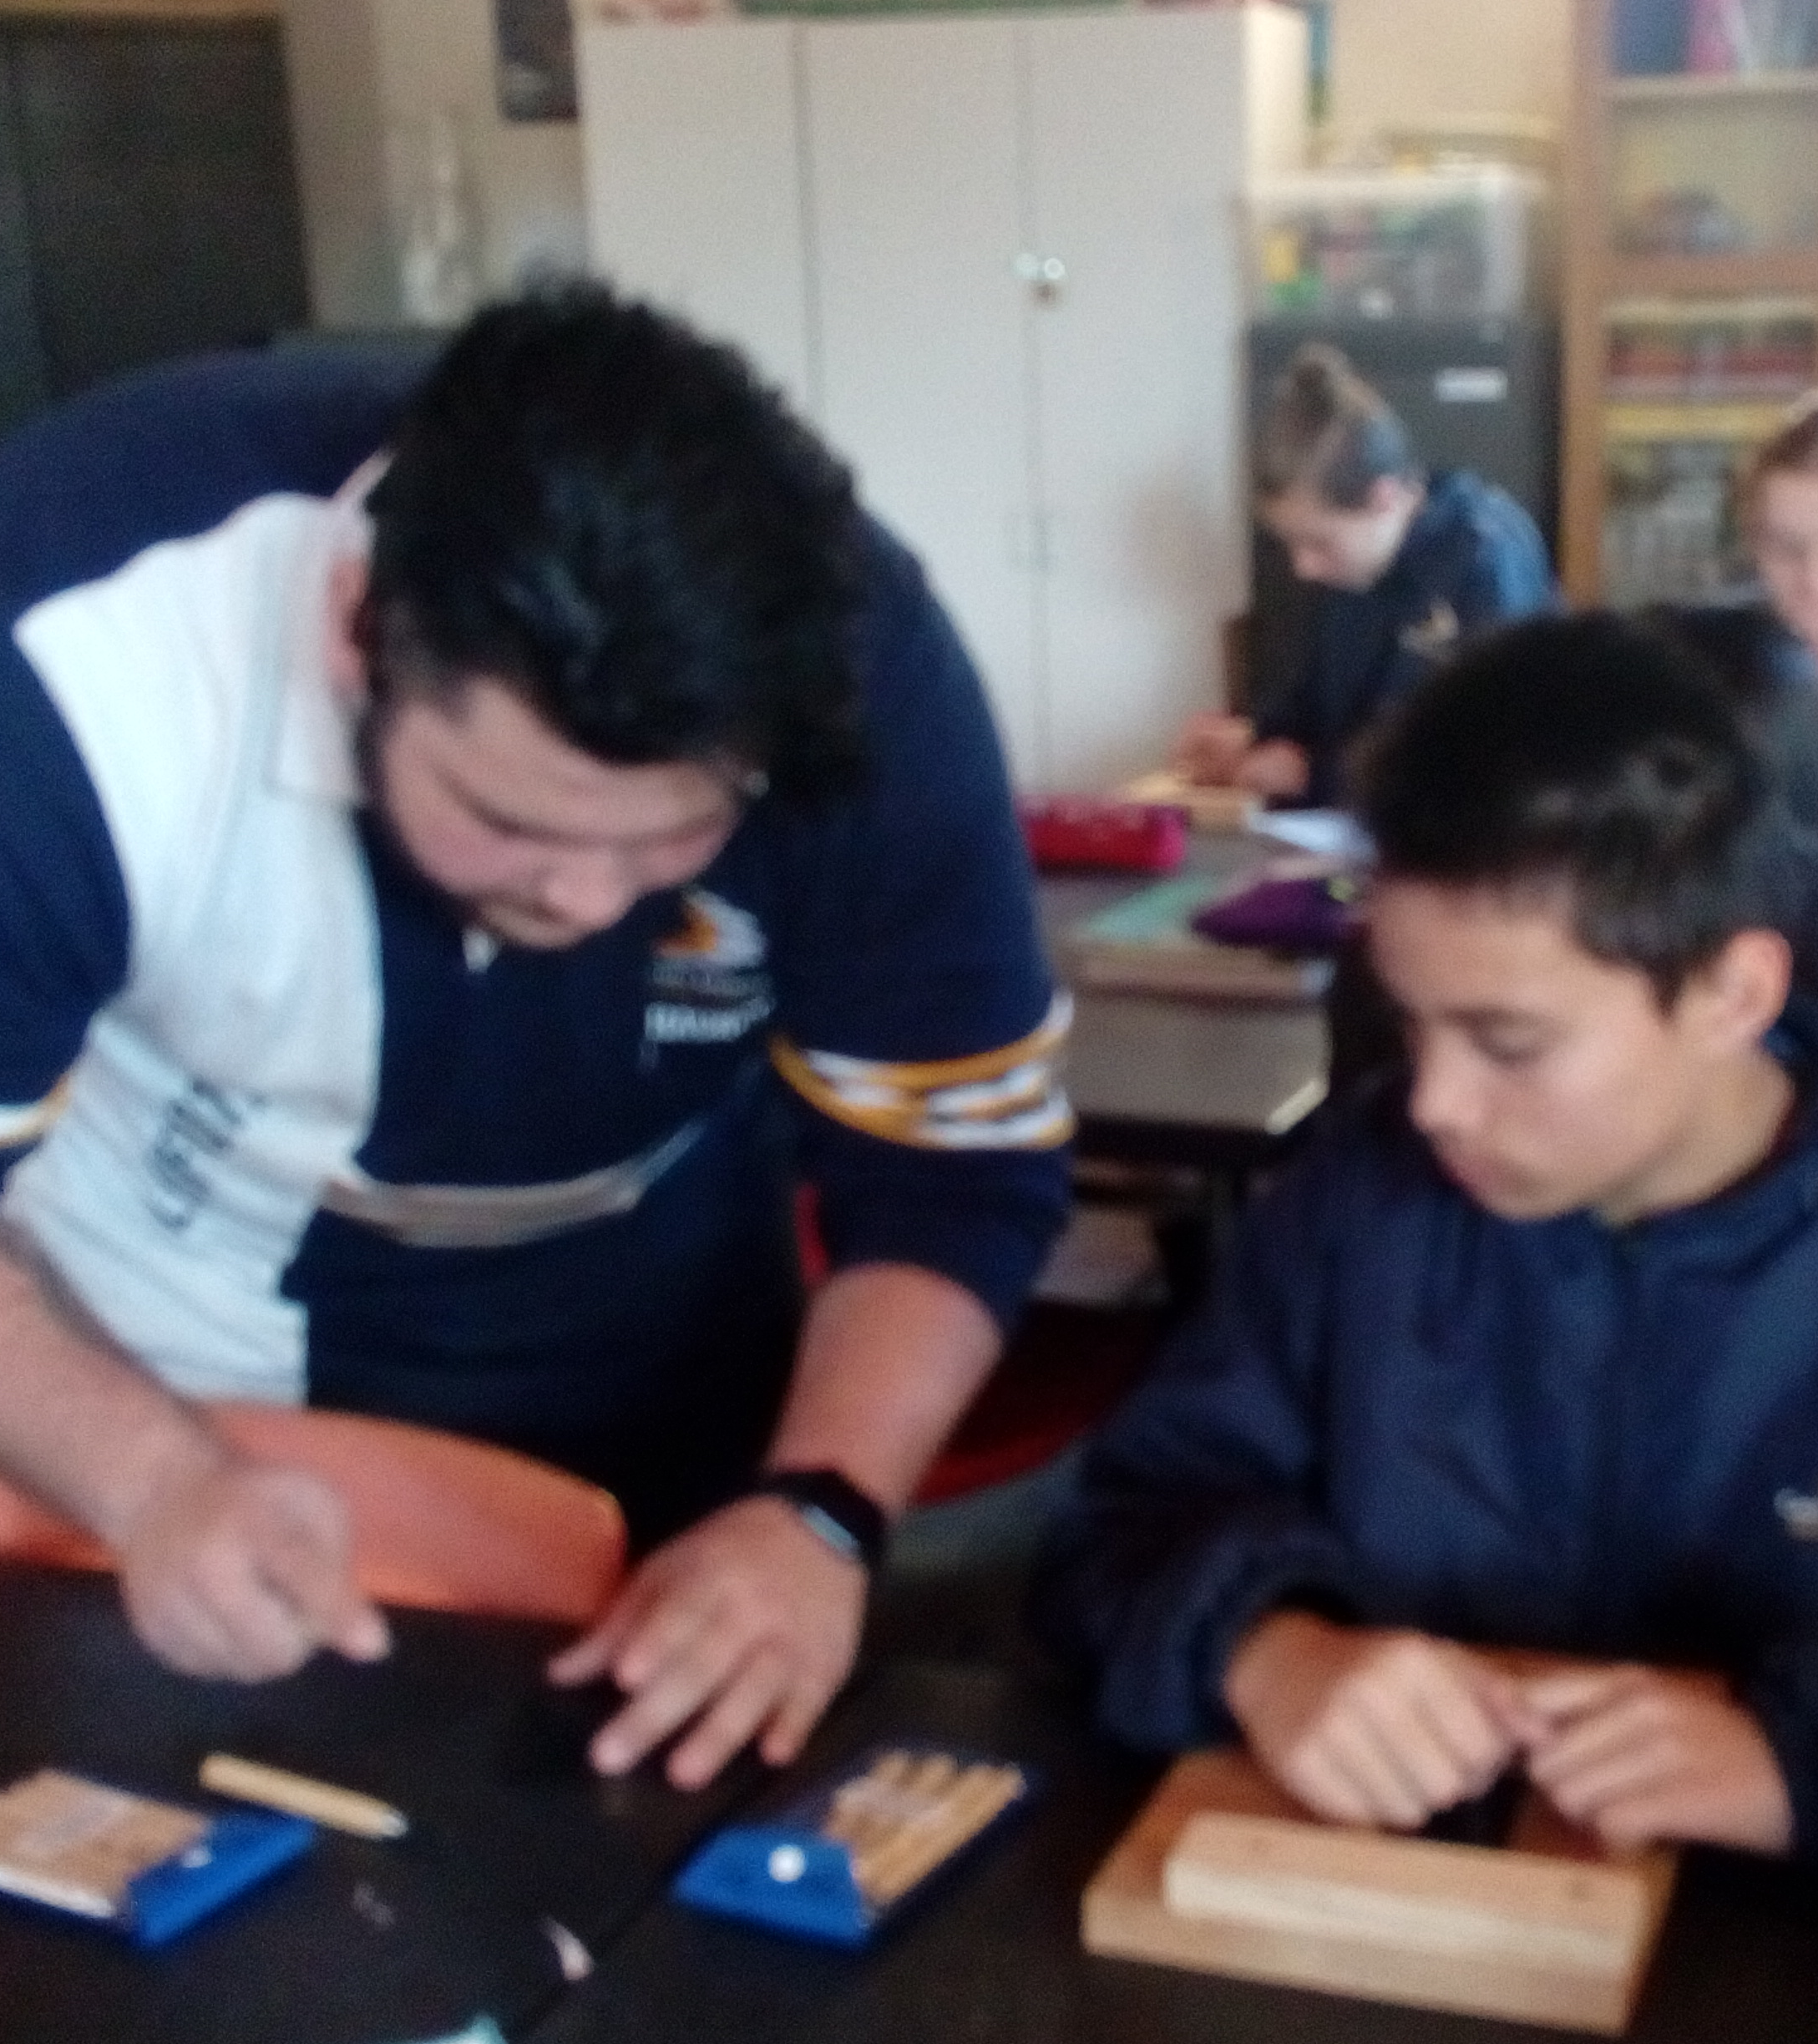
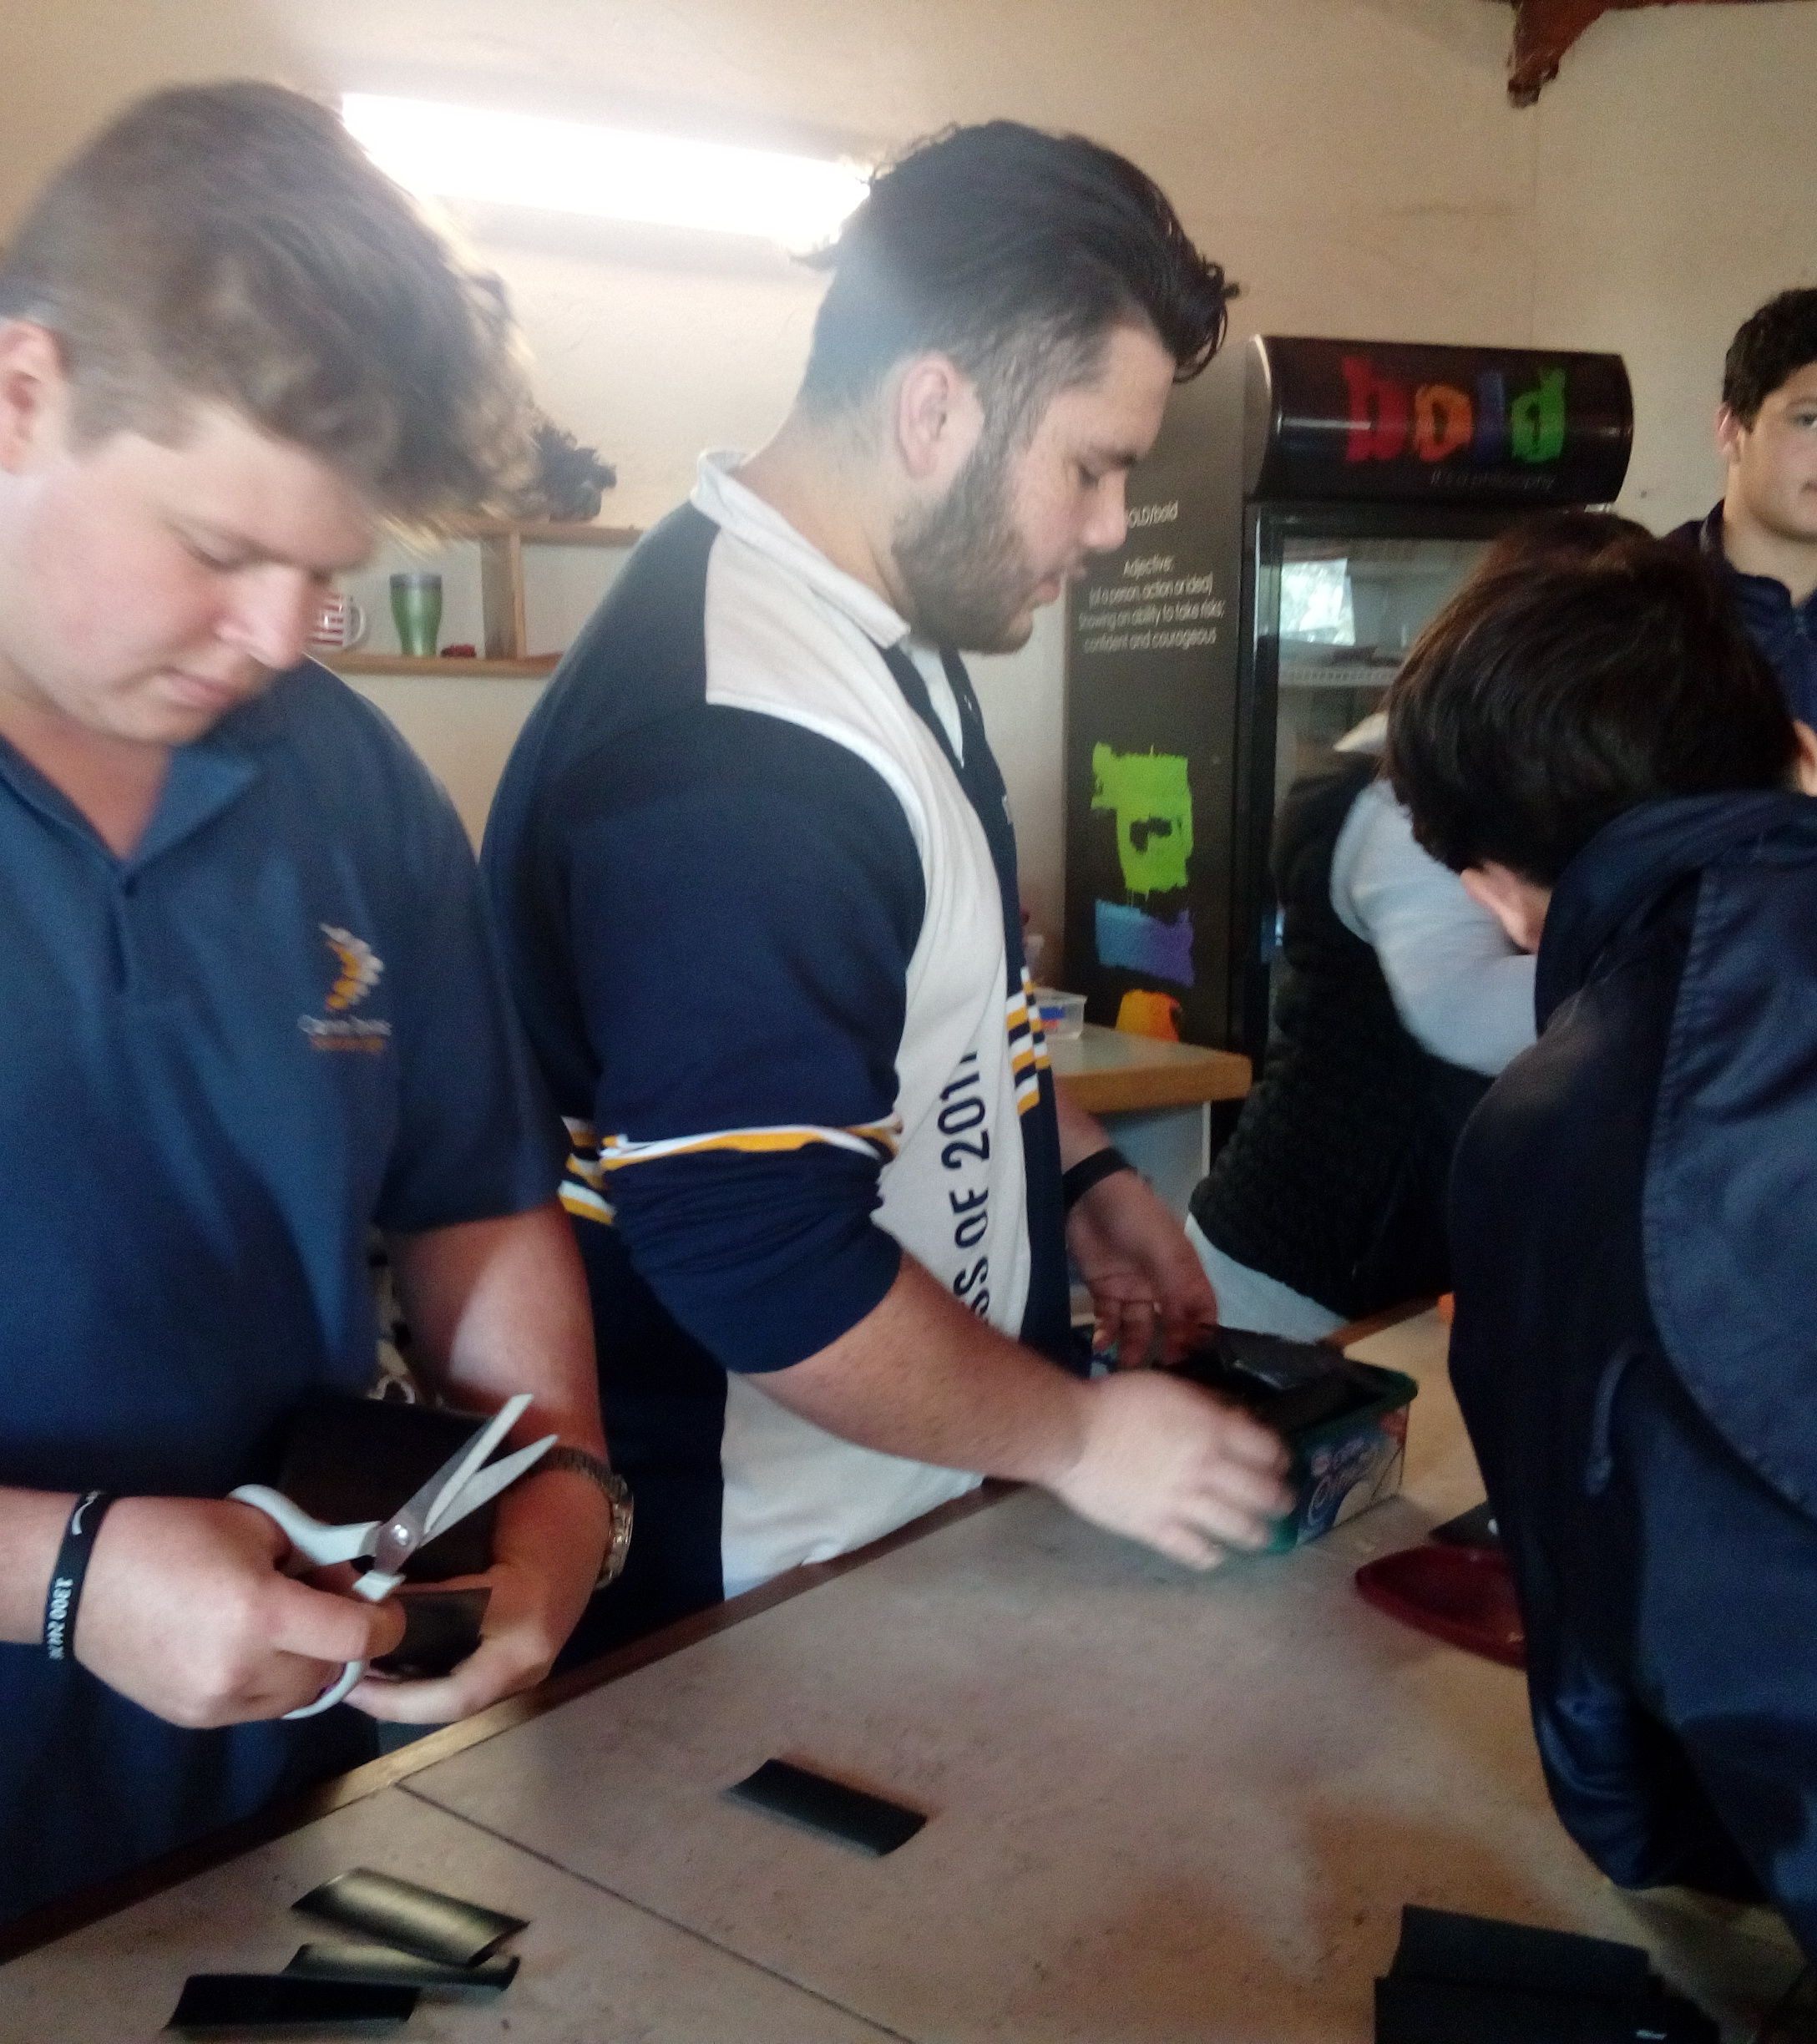
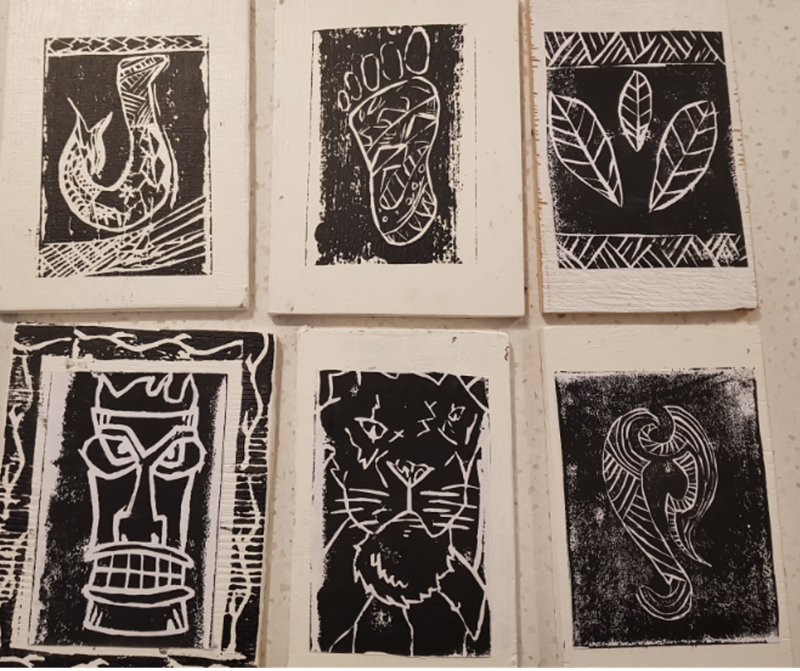
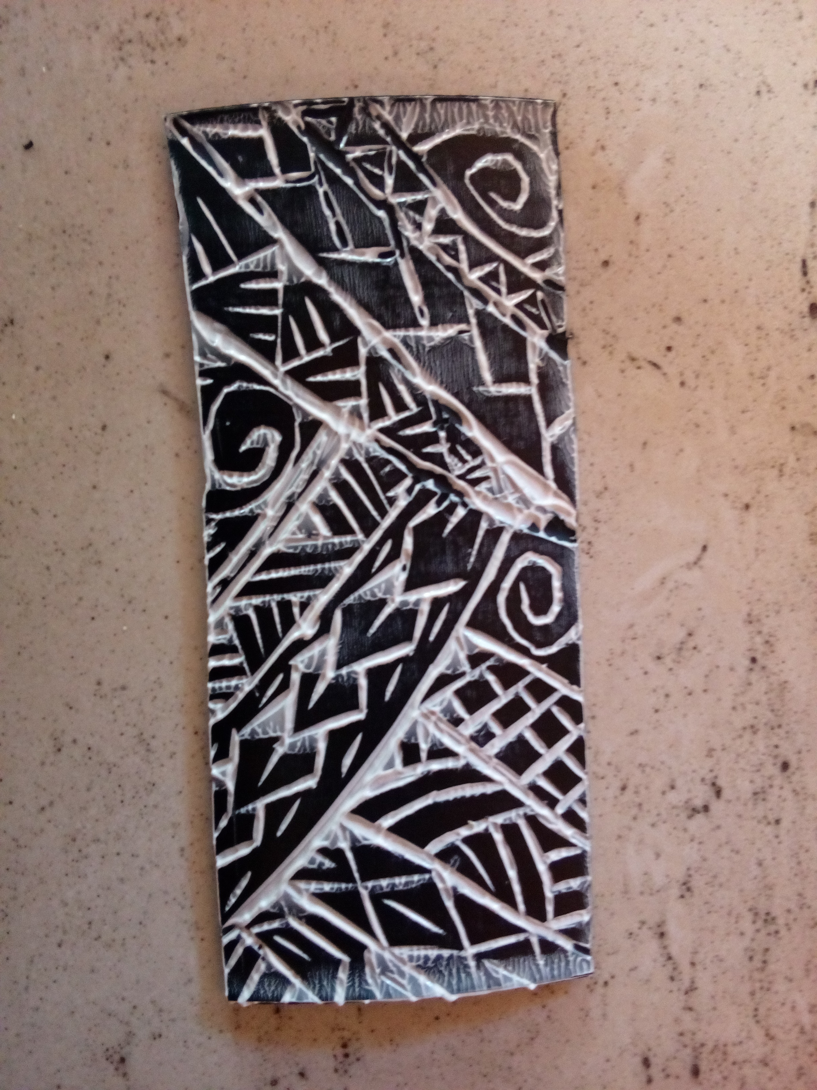
4C’s Curriculum Literacy & Numeracy WRS/PDS COMMUNITY ENGAGEMENT PRIMARY SCHOOLS & RETIREMENT HOMES
Leadership skills
Mentoring
Learning and teaching skills
How to assist
OHS – How to safely use equipment
Feedback/reflection
Improvement for future lessons
Problem-solving
Responsibility of setting up and packing up materials.
Creativity

Slide 14
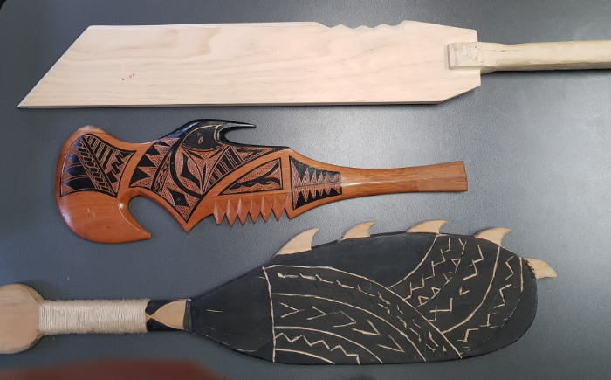
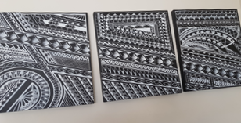
Curriculum Literacy & numeracy WRS/PDS LEADERSHIP SKILLS/MENTORSHIP
Safety Training in Wood Tech
Learning and teaching skills
Design and execution
OHS – How to safely use equipment
Feedback/reflection
Improvement for future lessons
Problem-solving
Responsibility of setting up and packing up materials.
Cultural Creativity
Celtic design

Slide 15
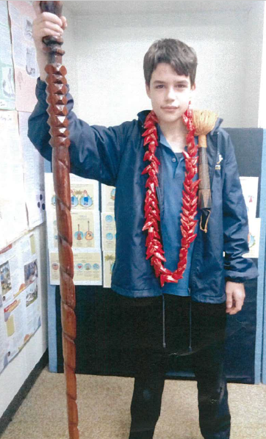
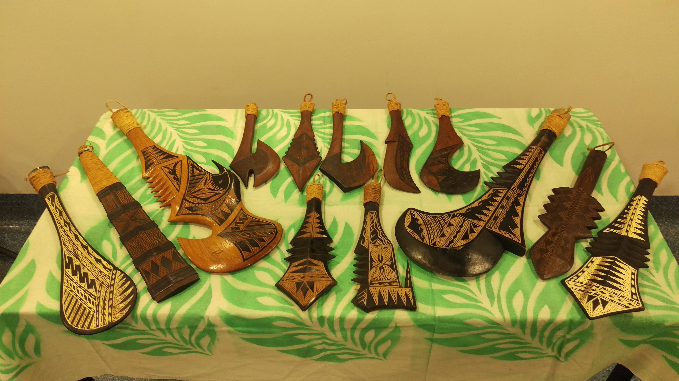
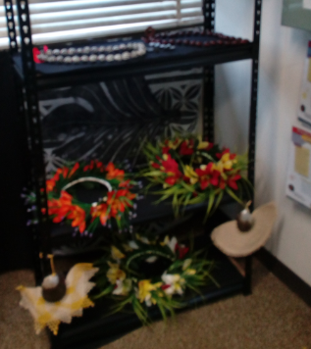
CROSS-Curriculum Literacy & numeracy WRS/PDS & YEAR 8 HUMANITIES POLYNESIAN EXPANSIon MINI MUSEUM
Primary & Secondary Sources
Sustainability
Creative Designs from various Islands
Recycling natural materials
History – stories and Carvings
Past to present
Problem-solving
Responsibility of setting up and packing up materials.
Cultural Creativity
Contextualise Indigenous history across the world

Slide 16
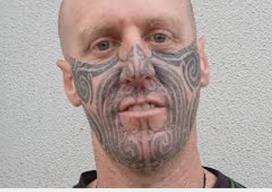
Tattoos that signify a personal journey or a family lineage

Slide 17
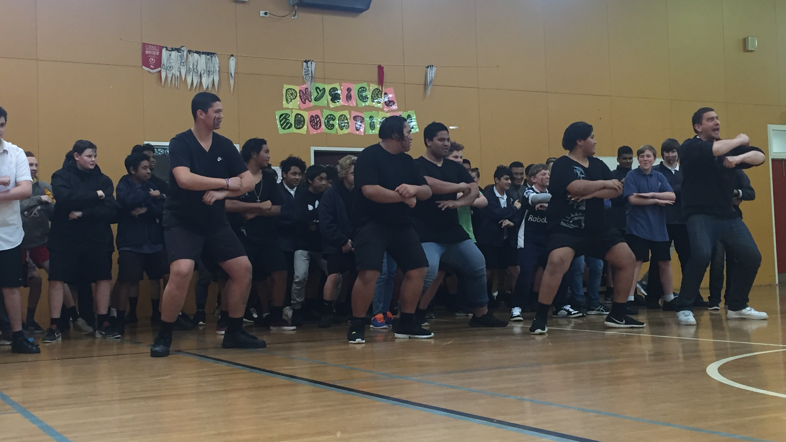
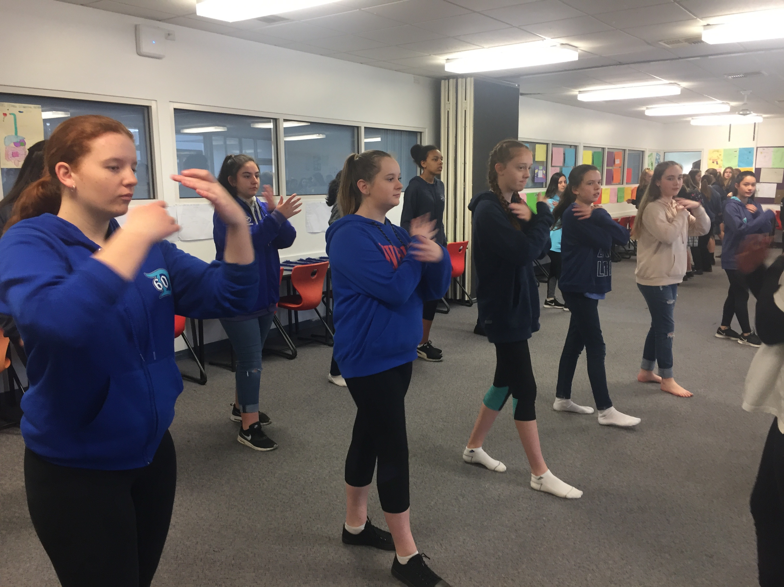
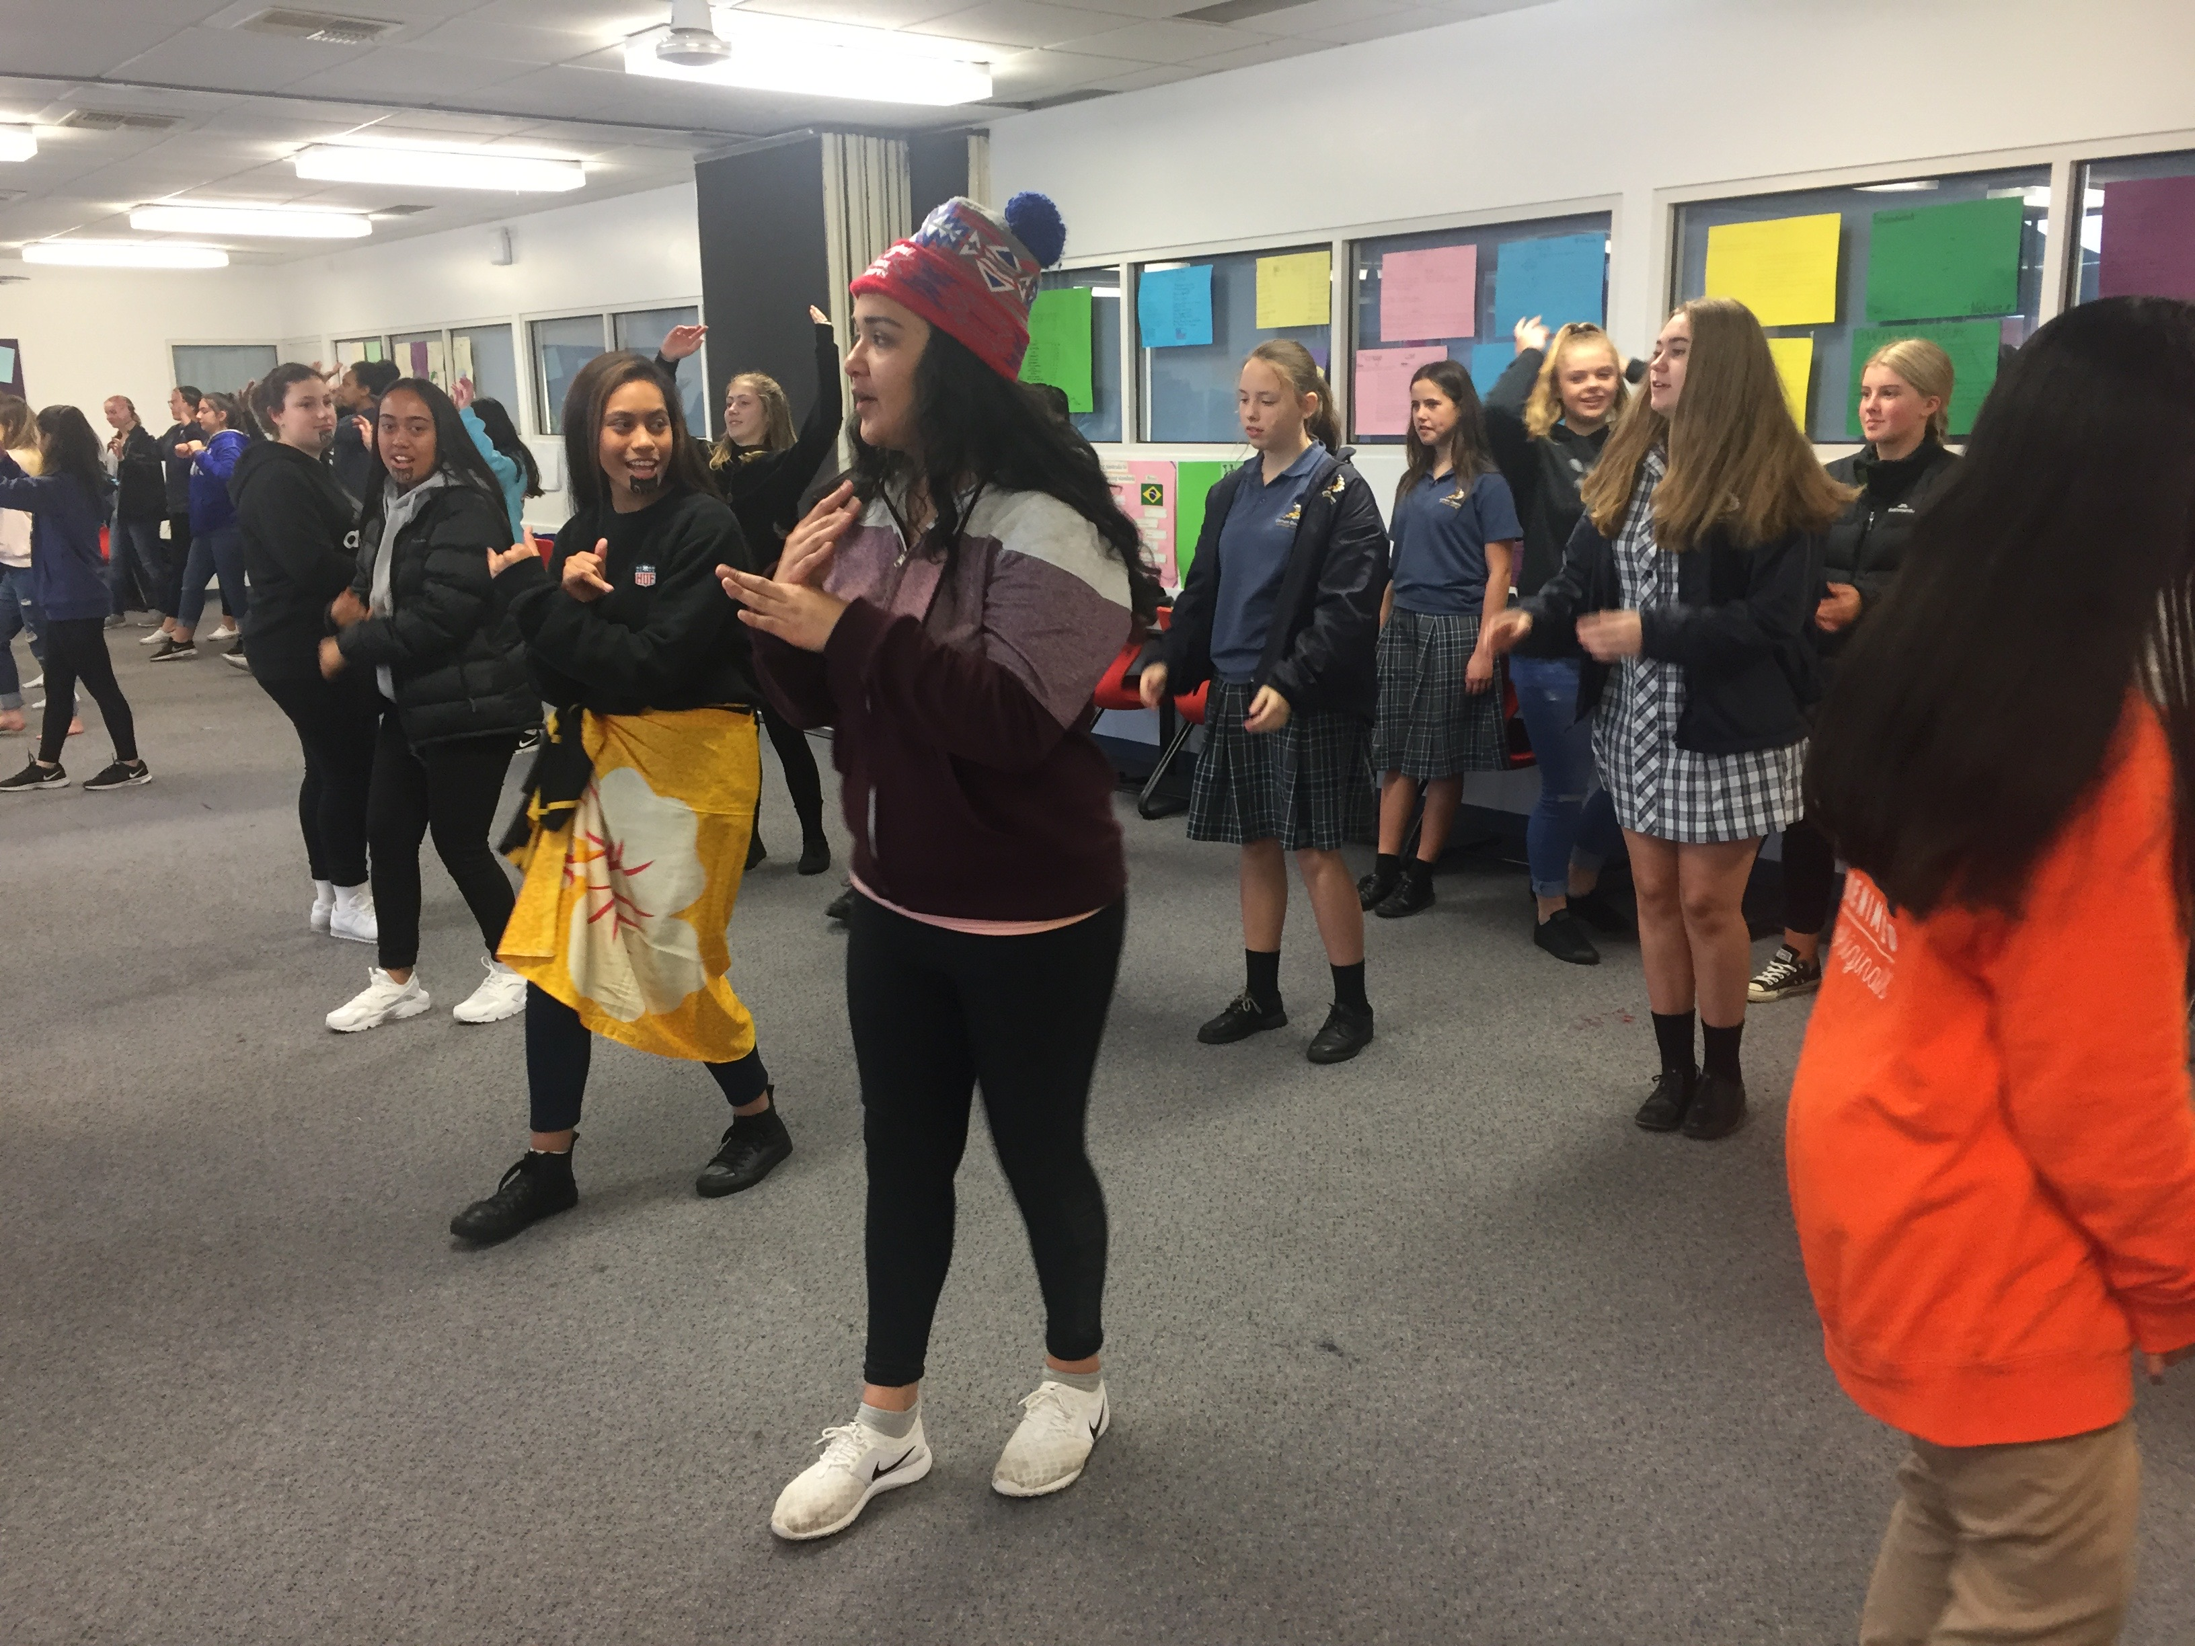
* Cultural knowledge and understanding * Haka – Cultural significance, meaning and pronunciation of words, the language * Students become the teachers – participation * Leadership training and support. * Planning and organising resources * Budgeting and sourcing funds * Presentations to Principal requesting funding. * Articulating needs and how it relates to learning * Learning respect and acceptance at any level of understanding culture.
CULTURAL INCLUSION

Slide 18
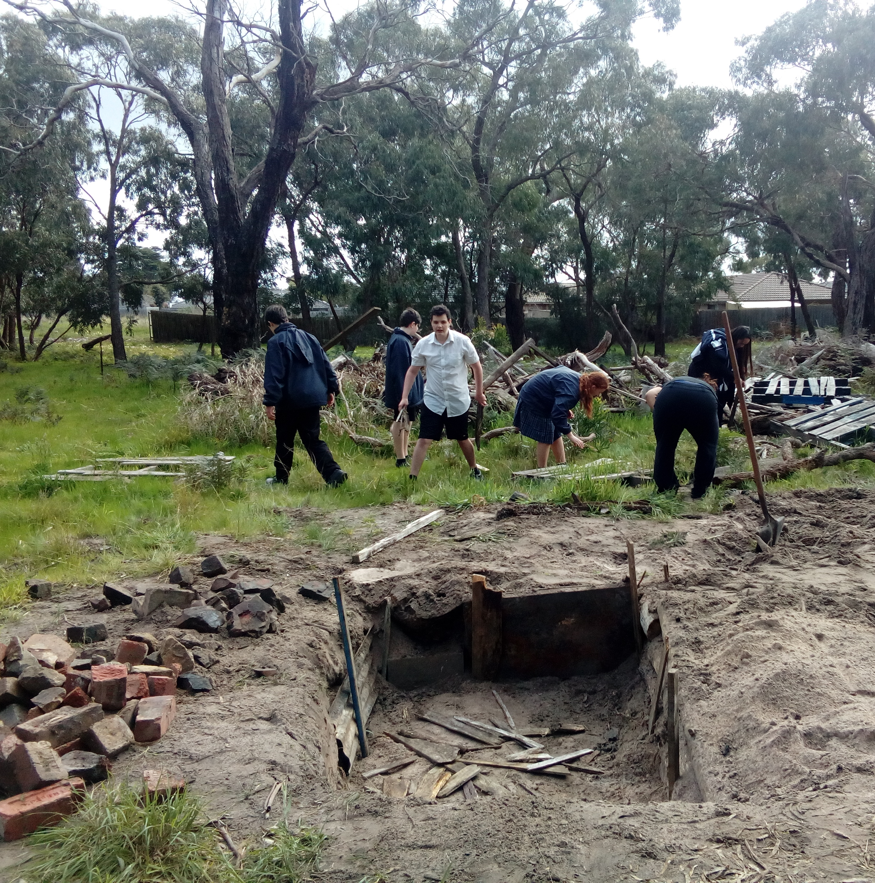
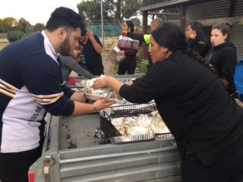
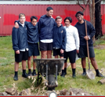
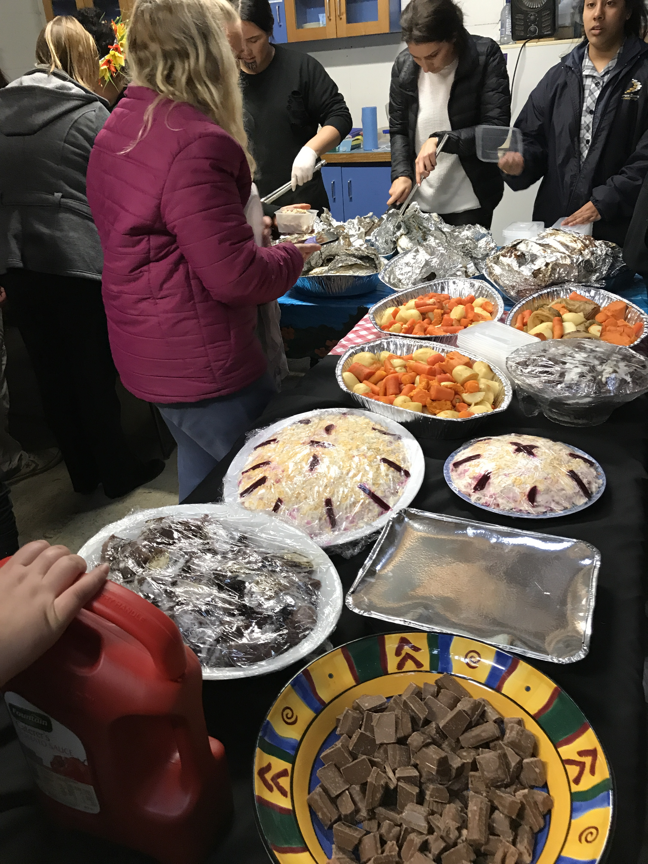
* Sharing a cultural meal * FOOD HANDLING CERTIFICATE * COMMUNITY SUPPORT – SKILLS * Leadership training and PREPARATION OF MATERIALS * ADVERTISEMENTS * NOTIFYING LOCAL FIRE station * Planning and organising resources * Budgeting and sourcing funds * invitation extended to Council members and teachers * Learning respect and demonstrating knowledge and understanding of hospitality and selflessness. * Mum’s in the kitchen to prepare food *dad’s building fire – preparation for cooking food
HANGI/UMU
COMMUNITY
ENGAGEMENT

Slide 19
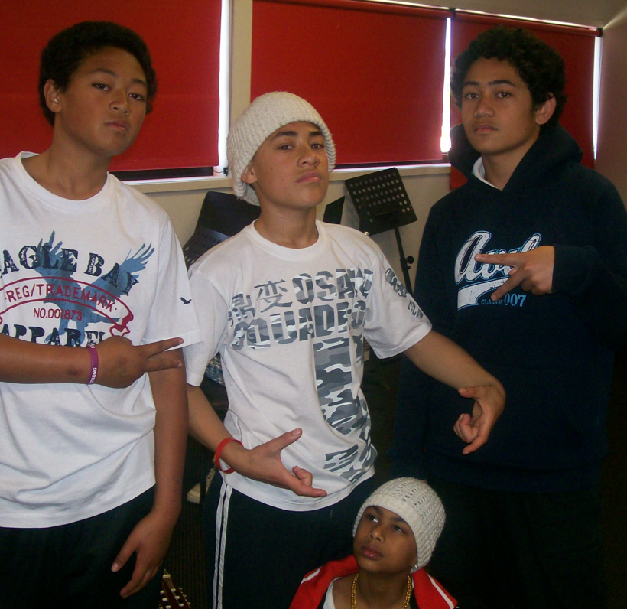
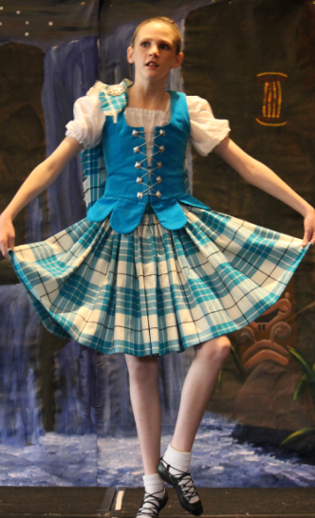
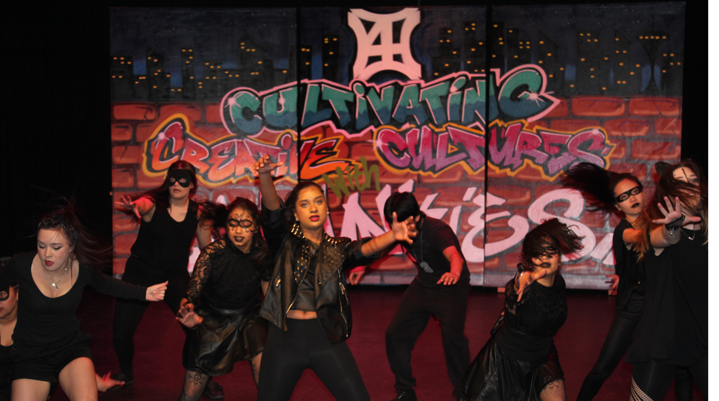
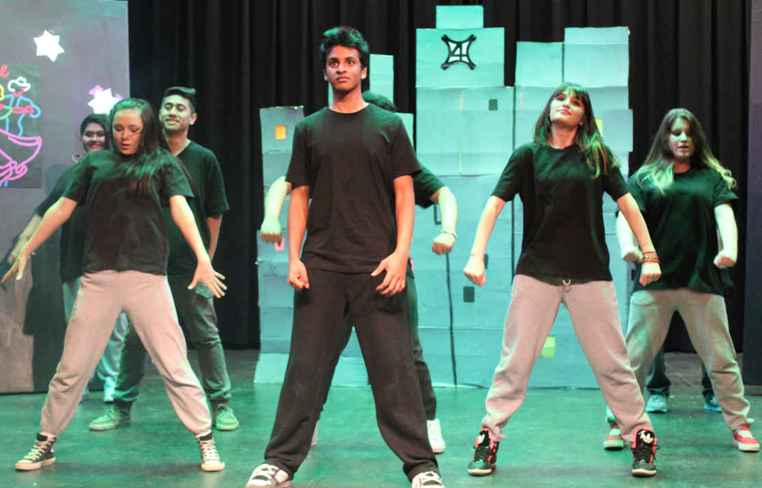
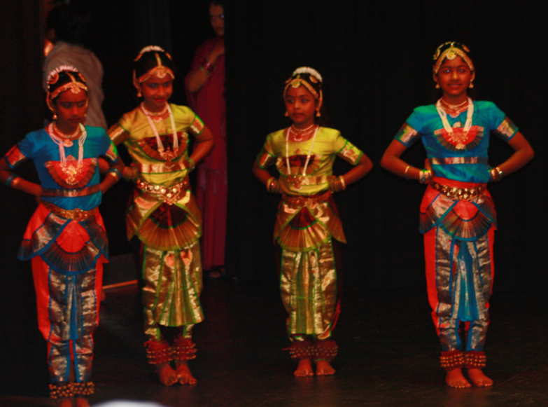
.
EVENT MANAGEMENT

Slide 20
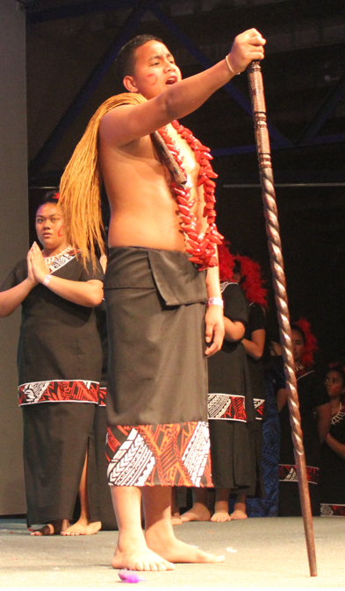
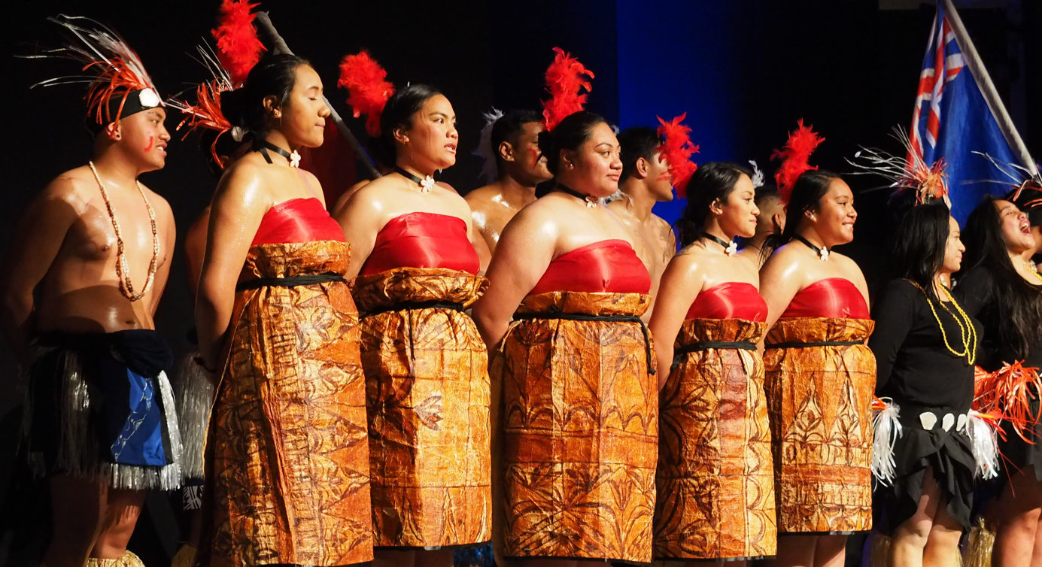
4C’s NIGHT 1
Last year 4C’s ran a
20-25 min cultural showcase with the following SECONDARY schools
SCHOOL PERFORMANCES
Monday 5th September 2022
Cranbourne East SC
Carrum Downs SC
Fountain Gate SC
Hampton Park
Independent school
St Peters College (CLYDE)
Narre Warren South P-12

Slide 21
Westall SC Gleneagles SC Lyndhurst SC Alkira SC Cranbourne SC Hallam Senior P-12
4C’s NIGHT 2:
Last year 4C’s ran a
20-25 min cultural showcase with the following SECONDARY schools
SCHOOL PERFORMANCES
Monday 12th
September 2022

Slide 22
4C’s 2023 school DATES & PerformanceS
See you there!

Slide 24
CLIPS FOR 4C’s
Introduction:
What is the 4C’s?
A student’s perspective of 4C’s
4C’s Concert Clips scattered 4C’s

Slide 25
WRS – BUNJIL PLACE EXCURSION
WE HAVE AN OHS - RISK ASSESSMENT
In JUNE 2023 COMPULSORY TO THE EVENT
NARRE WARREN TRAIN STATION
BUNJIL PLACE/LIBRARY
FOUNTAIN GATE - FOOD COURT

Slide 26
QUICK 4C’s QUIZ:
How many questions can you answer correctly?
If you were unable to answer at least 9 correctly, you will need to revise the PP, especially if you were unable to identify the 4C’s acronym and their values. ☺

Slide 27
QUICK 4C’s QUIZ:
1. What does the acronym 4C’s stand for?
2. What are the values that underpin 4C’s?
3. Define the meaning and purpose of a stakeholder.
4. List as many stakeholders involved in 4C’s as you can.
5. What is the current purpose of 4C’s and how has it changed?

Slide 28
QUICK 4C’s QUIZ: B
6. Is 4C’s a multicultural event or
just for the best dancers?
7. Apart from the performance side what other two options are available as part of the 4C’s showcase?
8. How old is 4C’s at the end of this year?
9. Can you list all of the schools involved in 4C’s this year?
10. Where will 4C’s be held and how guests does it hold a night?

Slide 29
4C’s questions about you!
11. Based on the activities students chose to do in the 4C’s PP, what tasks did you find interesting, or you would like to attempt this year?
12. Describe how you feel about organizing an event of this magnitude. List your concerns and discuss this with your group, peers and teacher.
13. Think about how you hope to make a positive change in this unit?
14 What kind of transferable skills do you think you will need to meet the outcomes for PDS?
15. What questions did you want to know but were not able to ask or find out today?

Slide 30
Thank you for your patience and for completing the quiz! If you have any other questions you would like to ask, please contact me on the email below.
Laitini Matautia-Ulugia
4C’s Founder/Director & Teacher
Laitini.matautia@education.vic.gov.au

