Slide 2
ACKNOWLEDGEMENT:
We proudly acknowledge the Traditional Owners,
Casey's Aboriginal communities and their rich culture and pay respect to their Elders, past, present and future.
We acknowledge Aboriginal people as Australia's First Peoples and as the Traditional Owners and Custodians of the land on which we live and work.

Slide 3
TAKE NOTES ON ONE OF THE MOST INCREDIBLE LANDMARK’S IN VICTORIA, THERE IS NO PLACE LIKE BUNJIL PLACE in the world.
WHAT IS BUNJIL PLACE? Think about the relevant information you need to know about the venue the 4C’s event is being held. Be aware of where to go and how to direct new groups who have never had the pleasure of being there.

Slide 4
WHERE IS BUNJIL PLACE? Bunjil Place is located next door to Westfield Fountain Gate shopping centre in Narre Warren.
WHAT IS BUNJIL PLACE? Bunjil Place is the City of Casey's vibrant arts, culture, community, and civic centre. Bunjil Place is an outdoor community plaza, theatre, multipurpose studio, function centre, library, gallery, and City of Casey Customer Service Centre all in one place. As the City of Casey's vibrant new entertainment precinct, it will be the creative and community heart of the region.

Slide 5
BUNJIL’S STORY FOR THE CITY OF CASEY BUNJIL PLACE
Bunjil the Creator and Bunjil Place
For the traditional owners of this land, the Boon Wurrung, Bunurong, and Wurundjeri peoples, Bunjil is the creator spirit that carved man from the land or clay. The building design evokes the Indigenous creator, Bunjil, a wedge-tailed eagle that floated above the earth and brought the world and life into existence. The building’s roof form floats like protective wings over the people who gather in this space, between the strong latticed timber forms that represent the feet of the eagle.

Slide 6
BUILDING DESIGN (FJMT) Francis-Jones Morehen Thorpe
FJMT, is the multi-award-winning architectural firm that developed Bunjil Place, after an internationally recognized competitive process.
“The inspiration from Bunjil Place is the ‘creator spirit’ of Casey’s First Nations people, who takes the form of an eagle in the dreaming.”
The iconic roof structure is designed to resemble the soaring eagles' wings with the world-renowned timber gridshell in the foyer acting as the legs.

Slide 7
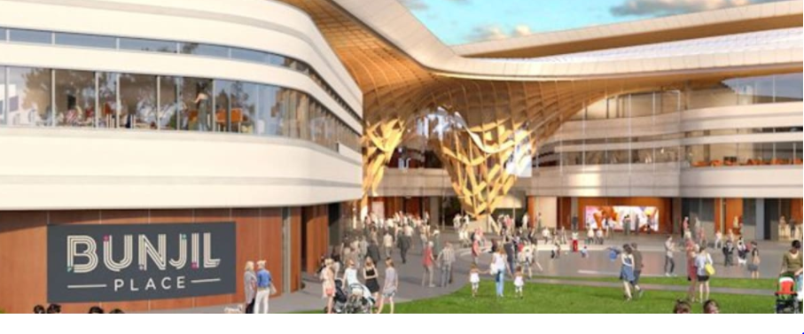
Council’s vision for the project was “To create an inviting central heart for the community, that celebrates participation, belonging and civic pride” This is still our vision for Bunjil Place today.”
THE BUILDING & PURPOSE
“The building’s shape is transformed into the outstretched form of the Bunjil, an ancestral eagle-like protector of the Kulin Nation. The building’s bird inflight plan is both a powerful and cultural symbol, acknowledging the land upon which the centre is built.”

Slide 8
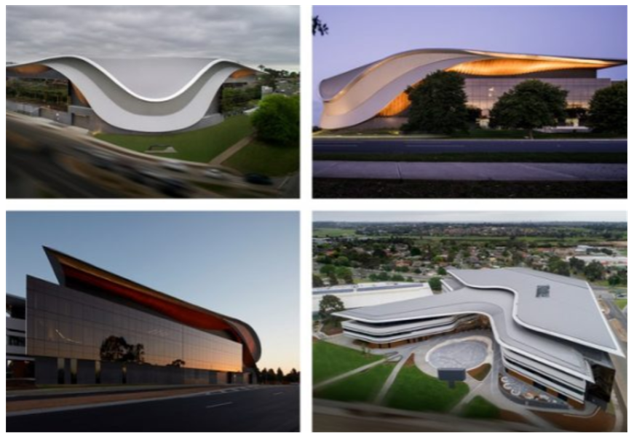
BUNJIL PLACE TOUR
Look carefully at the area and admire the enormous timber gridshell. The timber gridshell is a complex arrangement of prefabricated glue-laminated spruce. This was a world-first
OHS – Risk Assessment
Take note of any maps/entry/exit/safety maps stuck up all over Bunjil Place.
Ask the questions set by your chosen team.
Assess the spaces for where we will place 6 dancing groups. Are there enough spaces?
Refer to the short booklet created with questions on the day.

Slide 9
FOYER/ STAIRS BALCONY
The glass façade is 12m high. Large sheets of glass were melted into a special mold to achieve the exact curve of the building. They’re stacked vertically on top of each other and are self-supporting, held together with structural adhesive (kind of like industrial strength, double-sided tape.)
To not disturb the amazing light and sight-lines through the glass, the architects and structural engineers worked together to develop a sophisticated transparent glass column that sandwiches together multiple pieces of strengthened laminated glass, which is clamped together with metal discs.
When entering the foyer, take a moment to look up and admire the enormous timber gridshell. The timber gridshell is a complex arrangement of prefabricated glue-laminated spruce.
This was a world-first for this design and complexity. Each element was manufactured in Germany and shipped to the site in containers, then assembled on-site with interlocking plates and bolts – sort of like a sophisticated flat-packed feature, but without the giant Allen Key!

Slide 10
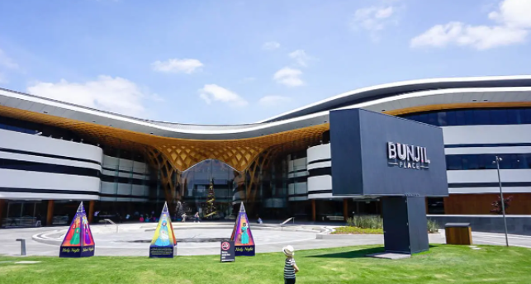
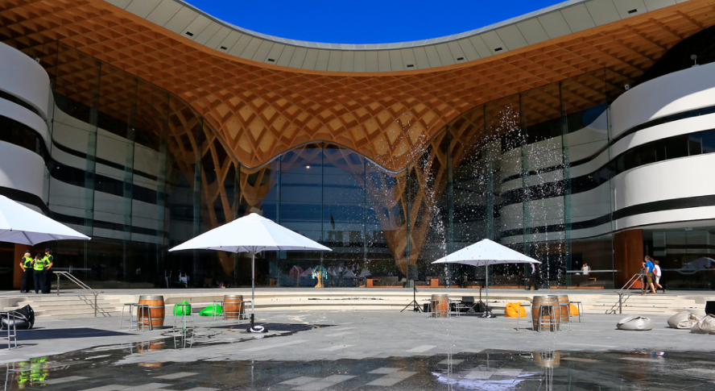
PLAZA
The Community Plaza is designed as an outdoor flexible space that can host all manner of different events. Rolling lawns provide the ideal spot to kick back on a deck chair in summer. The Amphitheatre is the sunken space in the centre and boasts one of three water features (a favourite among kids in warmer weather). The Promenade area (at the same level as the indoor area) is protected by the roofline and provides a great vantage point to view the big outdoor screen – especially when cold or wet weather kicks in. The screen uses the latest LED technology that creates an amazing viewing experience in full daylight, twilight, or the darkest night. Plus, in a first for Australia, the screen is mounted on a rotating stand so that it can be directed out towards the rolling lawns in warmer weather, or back towards the Amphitheatre and building during the cooler months.

Slide 11
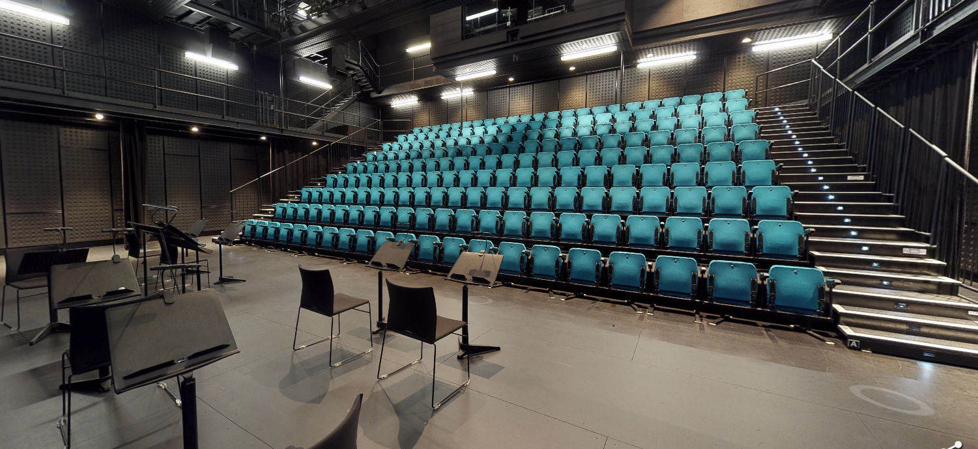
STUDIO
The Studio is a 362m2 flexible, creative space designed to be a blank canvas for contemporary and smaller performances and art forms. Already the Studio has hosted a range of programs including theatre, music, dance, cabaret, comedy, circus, art exhibitions, talks, and workshops. With automated and retractable seating for 200 or room to wipe the deck clear, the black box Studio has versatile technical capability, including a sacrificial floor suitable for dance performances and an AV loop linked to the Theatre.

Slide 12
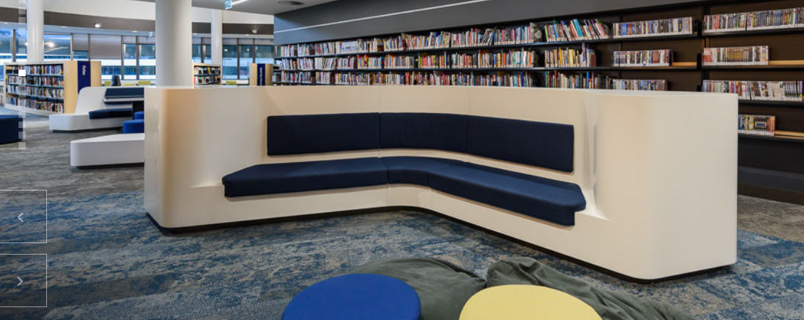
LIBRARY
Read through the work in the booklet you have been provided.
Art pieces from CESC will be displayed on the day and people can walk up the stairs or see the display through other entries
You will need to complete a Risk assessment for guests making their way to Bunjil Place.
Divide any questions you may need to ask regarding this area.
Set over three levels, this modern, light-filled community library has the capacity for a collection of around 50,000 items. Follow the curved staircase to the second level and soak up the light and views through generous windows. Features include an amphitheatre with terraced seating, a dedicated kids’ zone, a living-room style youth area with AV and gaming compatibility, 6m wide community art space, outdoor reading garden, public computer zones, quiet study nooks, and flexible meeting rooms (available for use by the public).

Slide 13
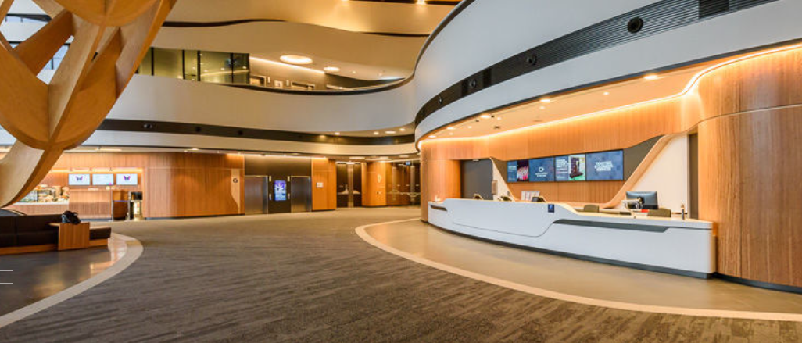
GALLERY
Look carefully at the area and admire the enormous timber gridshell. The timber gridshell is a complex arrangement of prefabricated glue-laminated spruce. This was a world-first. Our gallery throws light onto how Australian artists interpret our home, the world, experiences, and existence. The flexible space is reinvented with every exhibition, thanks to movable walls that can divide the space into multiple rooms and clever state-of-the-art lighting. With 4.5m high ceilings and an airlock entrance, humidity controls can be achieved and maintained, making this space capable of hosting touring exhibitions from the most prestigious art museums and lenders. As you exit the Gallery, check out the unique interactive touch wall (on your right, near the Studio entrance), where you can join our virtual community. (And with interactivity available at all heights from top to bottom of the screen, anyone can play!).

Slide 14
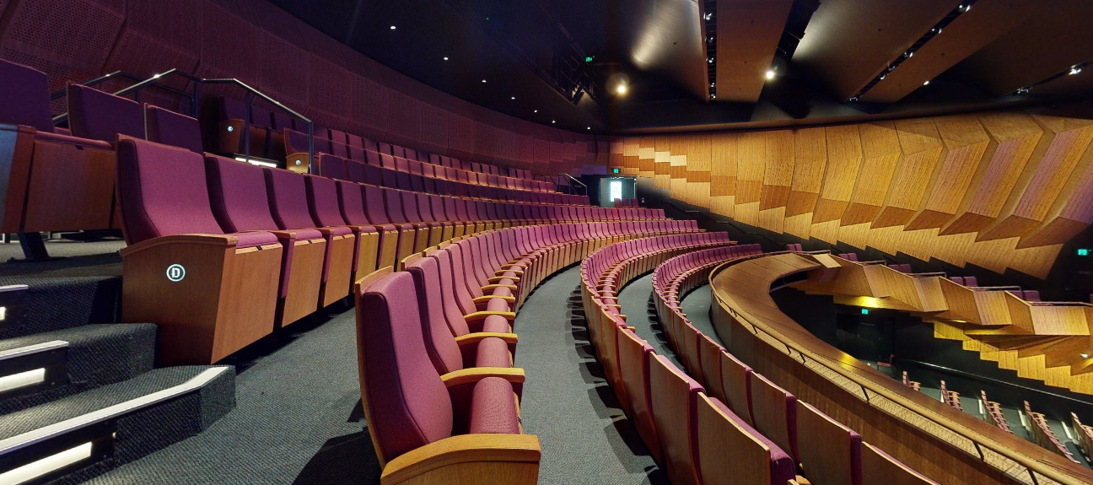
THEATRE
Every row and every one of the 846 seats throughout the stalls and dress circle in the Theatre has been carefully designed to achieve an unobstructed view of the full proscenium arch, so no one missed out on the action onstage. Cleverly designed acoustic timber panels are balanced to cleanly distribute sound to the very back seats in the house. The most impressive acoustic feature is that the entire concrete structure for the Theatre and Studio has been structurally separated so that no vibrations and sounds will transfer into the space and interfere with any performances. High above the stage soars a full fly tower. In addition to a motorized orchestra pit and state-of-the-art tech and back-of-house facilities, the Theatre also features a hearing loop and a viewing room – ideal for parents with crying babies- where you can watch the action through the soundproof glass and still hear what’s happening onstage through the viewing room’s PA system.

Slide 15
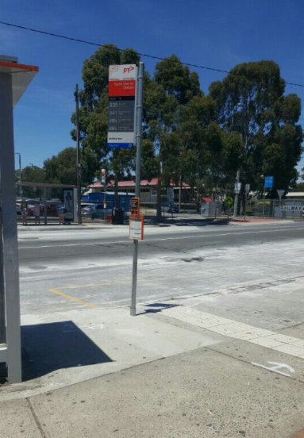
NARRE WARREN TRAIN STATION
Read through the work in the booklet you have been provided.
Make sure you choose your groups based on how well you will work with them.
You will need to complete a Risk assessment for guests making their way to Bunjil Place.
What information will they need to know to get to the event on time?
There will be questions you will be required to answer on your arrival to Narre Warren station. Divide the questions up among your group to maximise your time at the station.

Slide 16
OHS EXCURSION IN JUNE 2023
If your school have opted for you to attend an excursion for OH&S. You need to listen carefully to what the evidence and information you are expected to collect.
It is important that you ask your teachers to support you with the answers to the questions in the booklet WHILE you are on the excursion. There will be different tasks for Year 11 and Year 12’s to complete based on the outcomes your school has chosen to meet.

Slide 17
REFERENCES:
ADDITIONAL BUNJIL PLACE INFORMATION:
https://www.jacarandaindustries.com/bunjil_place
https://www.bunjilplace.com.au/about
https://www.studiobinocular.com/projects/bunjil-place/
https://my.matterport.com/show/?m=65yiEH8NR6r
https://www.bunjilplace.com.au/theatre
Bunjil Place bird worksheets: Story 1 and Activity 2

Slide 18
Thank you
For your patience and excellence in paying attention to the presentation. Make sure you remember what to bring on the day!!!!!

