Slide 1
4C’s STAKEHOLDERS
2022

Slide 2
4C’s have developed a Community connection led by Lyndhurst SC and in partnership with Cranbourne East SC.
Students in Year 11 and 12 will be participating in various tasks based on their interest and skills.
Be prepared to visit the Bunjil Place website for all the relevant information and tasks available for teacher and student use.

Slide 3
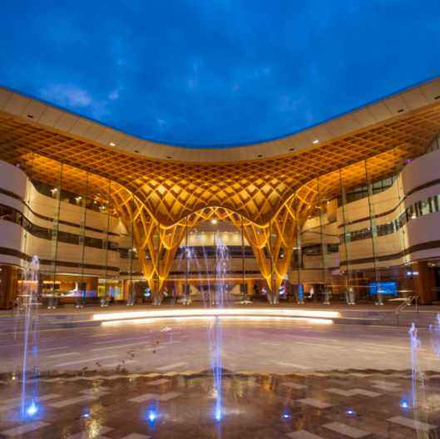
WHAT ARE
STAKEHOLDERS?
Stakeholders are those
with an interest in your project's outcome
and are typically
Members of a project team
Project managers
Executives
Project sponsors
Customers and users

Slide 5
4C’s STAKEHOLDERS
BUNJIL PLACE (City of Casey)
ERDI FOUNDATION (Sponsor)
LE MANA (CMY Centre for Multicultural Youth)
VICTORIAN POLICE (Multicultural Casey/Dandenong)
GRACE CONNECTIONS Community/Charity work
MUSEUM/STATE LIBRARY Jade Hadfield- Curator from Melbourne Museum to Bunjil Place.

Slide 6
4C’s STAKEHOLDERS
BUNJIL PLACE (City of Casey)
ERDI FOUNDATION (Sponsor)
LE MANA (CMY Centre for Multicultural Youth)
VICTORIAN POLICE (Multicultural Casey/Dandenong)
GRACE CONNECTIONS Community/Charity work
MUSEUM/STATE LIBRARY Jade Hadfield- Curator from Melbourne Museum to Bunjil Place.

Slide 8
Bunjil Place’s role in 4C’s
Bunjil Place is the City of Casey’s leading arts facility, named after the stories of Bunjil the ‘creator,’ from its First Nation’s People.
Bunjil Place aims to be the most inclusive arts and culture in Australia and a place for opportunities and community connectedness. Bunjil Place’s role is as a partner in 4C’s and is invested in the outcomes of students and their curriculum and promoting cultural expression in a culturally safe manner.
Bunjil Place is dedicated to supporting inclusivity and community connectedness through 4C’S, through supporting local culturally and linguistically diverse young people in the community in hopes to foster artistic connectedness and pride.

Slide 9
Bunjil Place is dedicated to supporting the success of 4C’s, through supporting the performance outcomes including marketing, production, and administrative support. Final performances and exhibitions of works will be presented at Bunjil Place to promote the public’s understanding of the importance of the diversity of cultural expressions.

Slide 10
WHAT YOU SHOULD KNOW ABOUT BUNJIL PLACE
The Story of Bunjil Place
in Melbourne

Slide 11
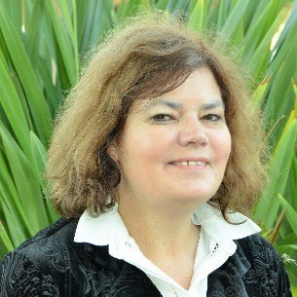
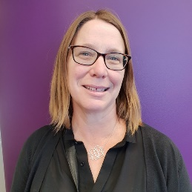
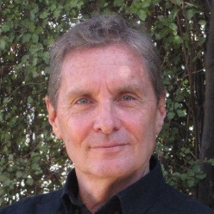

Slide 12
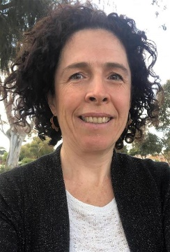
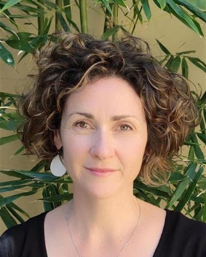
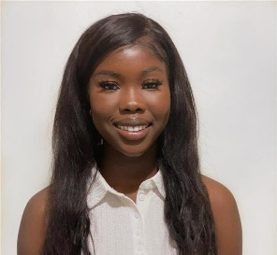

Slide 13
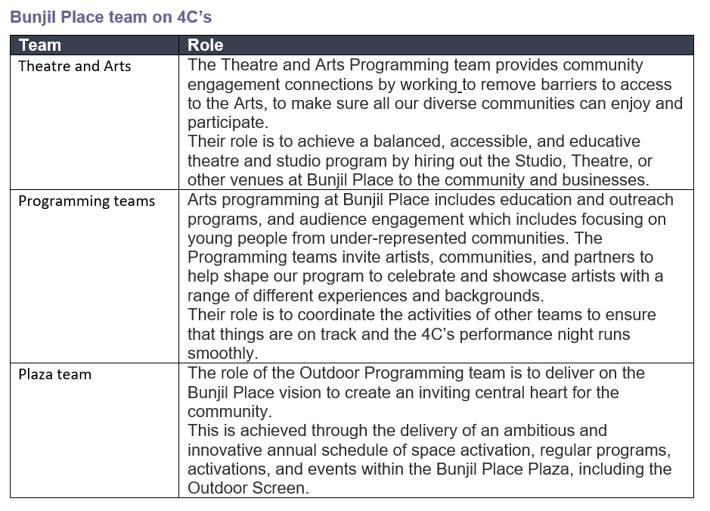

Slide 14
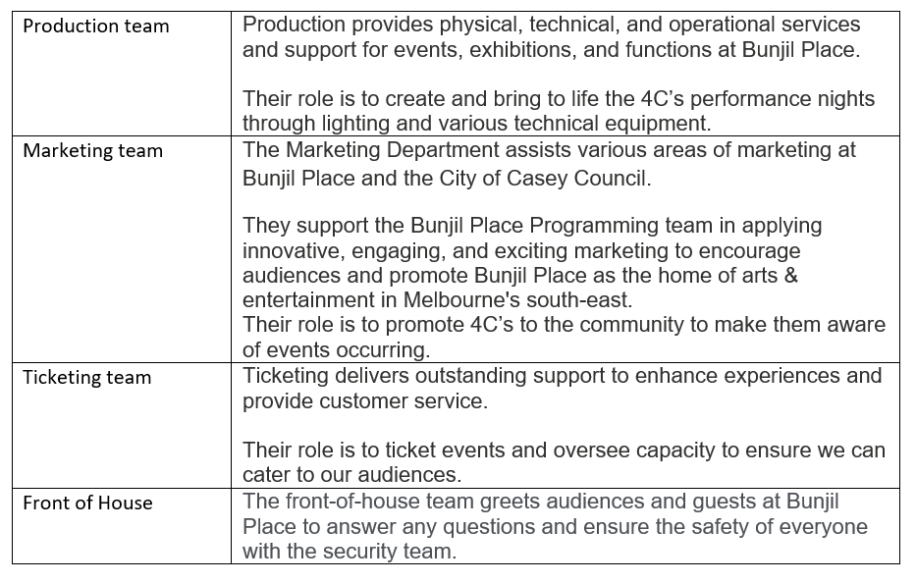

Slide 16
WHO & WHAT IS THE HERDI FOUNDATION?
https://www.erdigroup.com.au/community.html
The Erdi Foundation was established in 2014 with the mission to strengthen community life and to address disadvantage in Australia and Israel

Slide 18
WHO & WHAT IS THE HERDI FOUNDATION?
https://www.erdigroup.com.au/community.html
Les Erdi, is a charitable organisation that share and can help advance this mission:
promote community values, foster community cohesion, and generally work to improve the quality of community life for young and old
address inequality and support the most vulnerable and marginalised people in our society
empower people who are spirited, entrepreneurial, and willing to tackle life’s big challenges
support environmental causes that not only protect the planet but have an immediate impact
advance community health
The Erdi Foundation is committed to the values of caring, equality, integrity, excellence, and better practice.

Slide 19
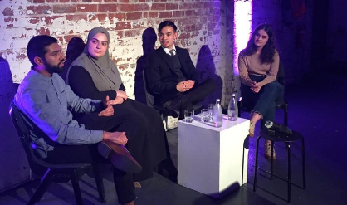
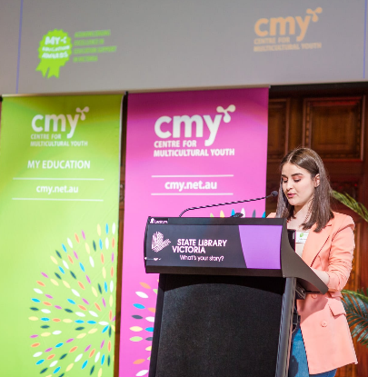
Check out their website
https://www.cmy.net.au/

Slide 20
CMY Centre for Multicultural Youth
https://www.cmy.net.au/about-us/

Slide 21
CMY Centre for Multicultural Youth
LE MANA
PASIFIKA

Slide 22
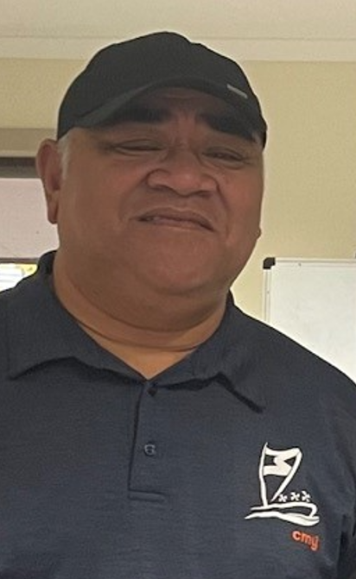
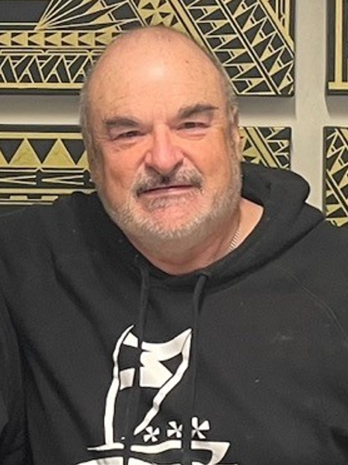

Slide 23
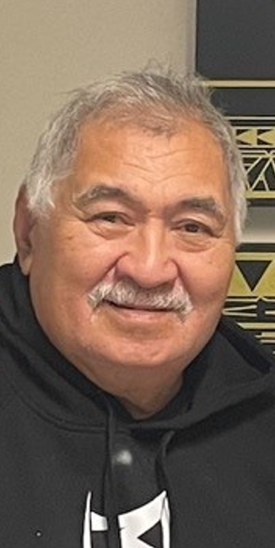
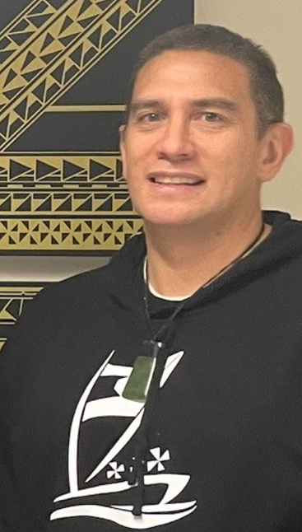

Slide 24
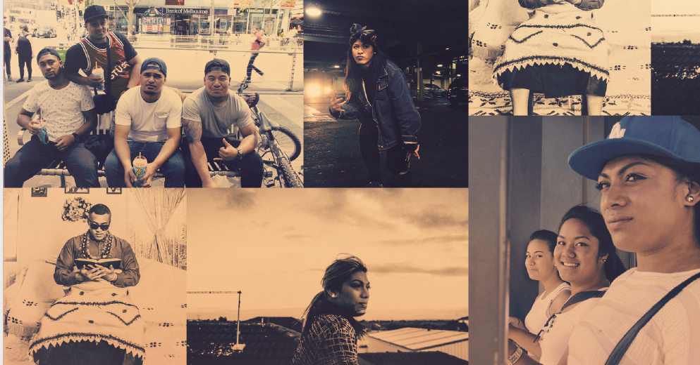

Slide 26
Safety Officers on 4C’s nights
Grace Connections, is a charity group that works in the Community. The sole purpose for these fathers and Grandfathers, is to work as unofficial security support for each of the 4C’s nights.
Most of their children have participated in the program and now family members and their grandchildren or relatives will either be performing or will be participating once they reach the appropriate age.
They enjoy supporting all the young people involved in the event and encourage students to connect to their culture, and or learn about the cultures of others.

Slide 27
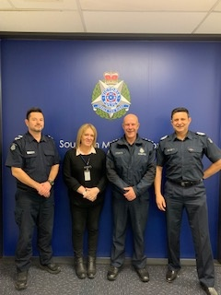
MULTICULTURAL POLICE
Leading Senior Constable James Waterson, Southern Metro Multicultural Unit.
NECLO Nicky Turner, Southern Metro Multicultural Unit.
Inspector Gerard De Vries Community Engagement Inspector Southern Metro Region.
Senior Sergeant Hafiz Mayar, Unit Commander, Southern Metro Multicultural Unit

Slide 28
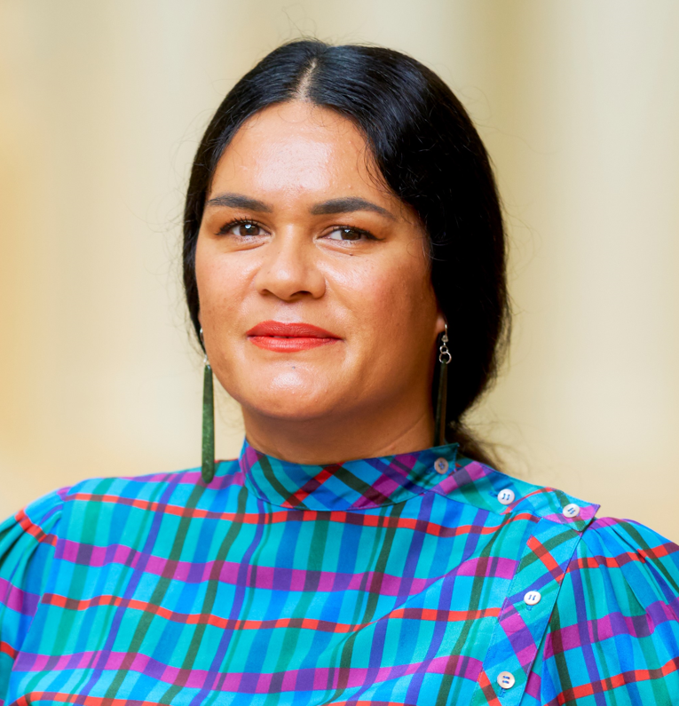
Jade Hadfield Ngāti Kahungunu, Ngāti Whātua o Kaipara
EXHIBITION CURATOR &
AUDIENCE ENGAGEMENT
Jade is a conservator and curator living in Narrm, Melbourne. She has over twelve years of experience at leading cultural organisations, including Te Papa, ICCROM, The Koorie Heritage Trust, and Museums Victoria. Jade is currently a curator at State Library Victoria, an honorary associate at Museums Victoria, and a member of the Australian Museum’s Pacific Gallery Curatorium. She also works collaborates with Bunjil Place on various projects.
Jade is committed to diverse representation and building capacity for Pasifika in the Victorian cultural sector. She has helped to facilitate access to various State collections for students.
Jade also sits on various boards and committees, such as the Waiohiki Marae Board of Trustees, Australian Museums and Galleries Association (AMAGA) Vic, and (MAP) Museum Accreditation Program Panelist.

Slide 29
QUIZ: 4C’s Stakeholders
1. What does 4C’s stand for? And what are their values?
C____________
C____________
C ____________ with
C____________________
VALUES: through ___________ ______________ and __________________

Slide 30
QUIZ: 4C’s Stakeholders
2. List the roles each of the 4C’s stakeholders will fulfil from the list below.
Stakeholders' roles:
Members of a project team:
Project managers:
Executives:
Partnerships:
Project sponsors:
Customers, clients, and users:

Slide 31
QUIZ: 4C’s Stakeholders
3. What kind of stakeholder is “Le Mana Pasifika Group”? What is their main goal and their main vision? What is their role in 4C’s?

Slide 32
QUIZ: 4C’s Stakeholders
4. The Victoria Police Multicultural Liaison Division will be present at 4C’s. What is their role/stake in 4C’s?

Slide 33
QUIZ: 4C’s Stakeholders
5. Bunjil Place has an Exhibition Curator who is working closely with 4C’s. What is her name and what is her role in 4C’s? What stake does she have with your project?

Slide 34
QUIZ: 4C’s Stakeholders
6. In a paragraph, explain who and what the organisation Erdi Foundation are? and how do they support communities?

Slide 35
QUIZ: 4C’s Stakeholders
7. Now that you know who our stakeholders are in the 4C’s project, do you think 4C’s can function without their partnership?
Explain your answer.

Slide 36
QUIZ: 4C’s Stakeholders
8. What role charity group Grace Connections play in 4C’s? Explain their reason for supporting 4C’s.

Slide 37
QUIZ: 4C’s Stakeholders
9. After exploring the CMY website, list all the services and programs they have available to young people and briefly explain at least 2 programs/services you think would be relevant to young people today.

Slide 38
QUIZ: 4C’s Stakeholders
10. Now that you know the importance of connecting to our stakeholders, please make a point of getting to know them. Make a point of introducing yourself at the event, take a photo, and thank them for supporting us in organising our event!

Slide 39
REFERENCES:
ADDITIONAL BUNJIL PLACE INFORMATION:
https://www.jacarandaindustries.com/bunjil_place
https://www.bunjilplace.com.au/about
Bunjil Place bird worksheets: Story 1 and Activity 2

